Slide 1
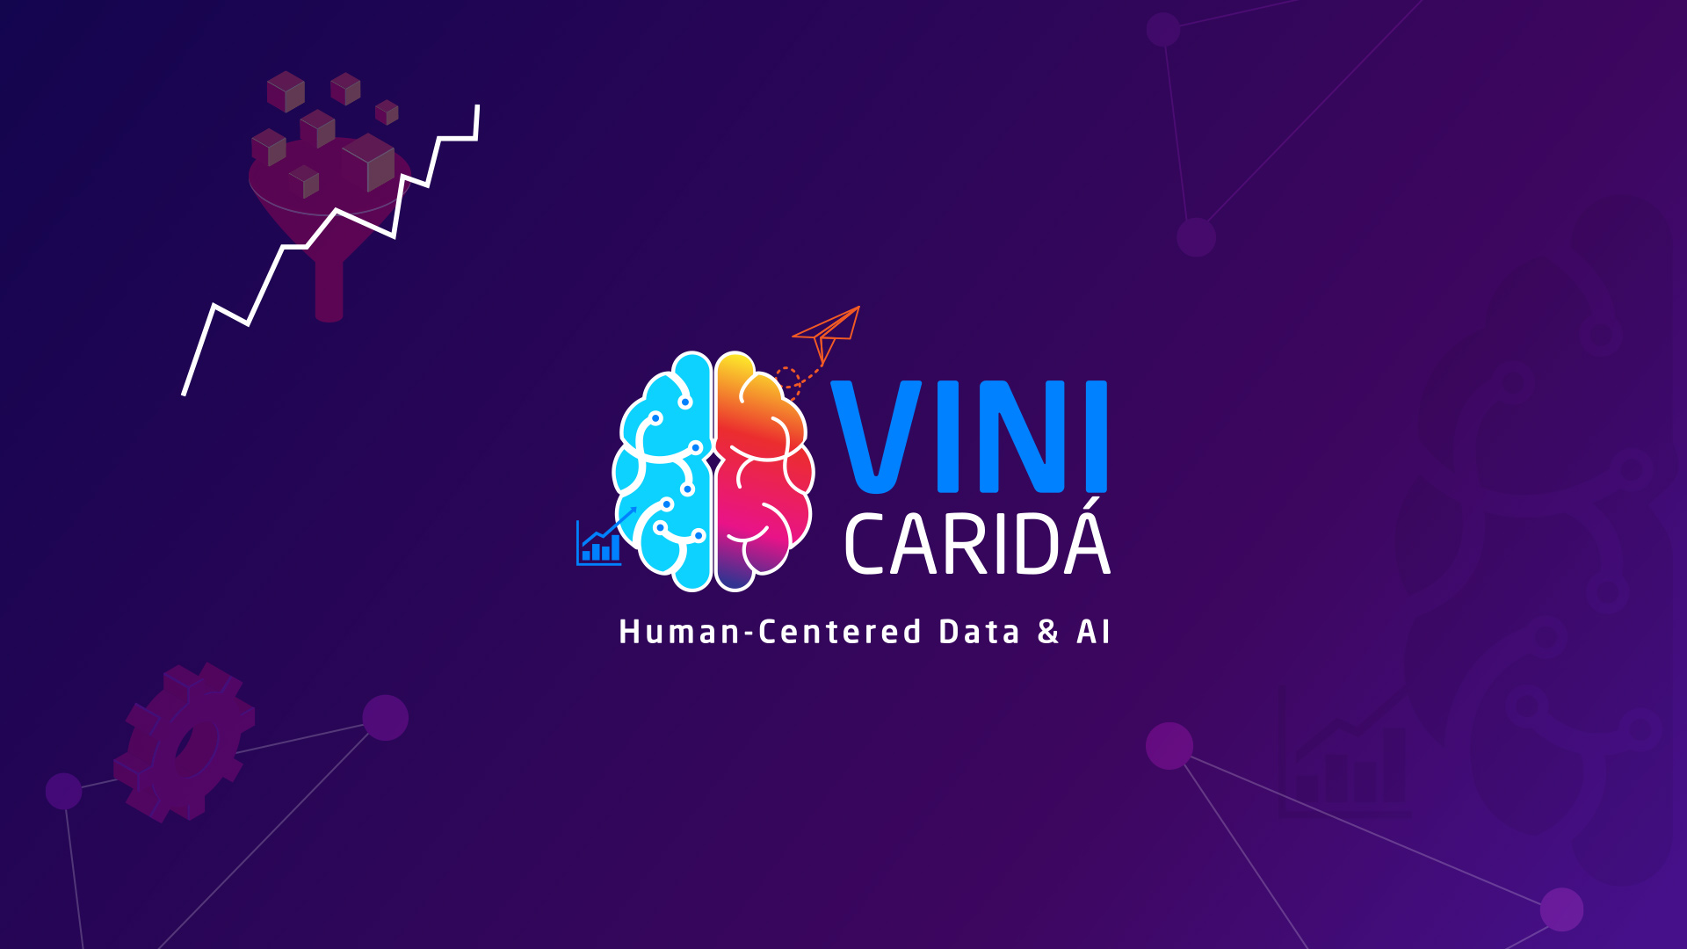

Slide 2








Vinicius Caridá, Ph.D.
Executive Specialist, Artificial Intelligence and Data - Itaú
MBA Professor – FIAP and ESPM
@vinicius caridá
@vfcarida
@vinicius caridá
@vfcarida
@vinicius caridá
@vfcarida

Slide 3

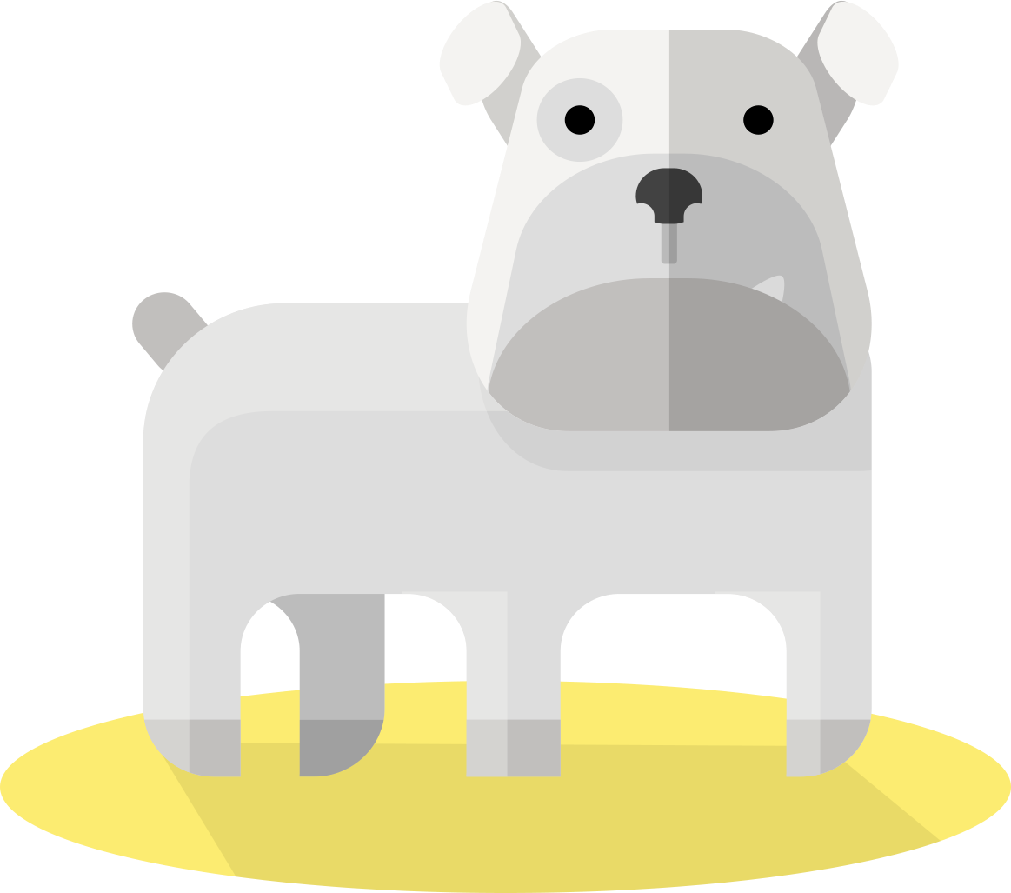
What about a dog and a mop? Easy, right?

Slide 4

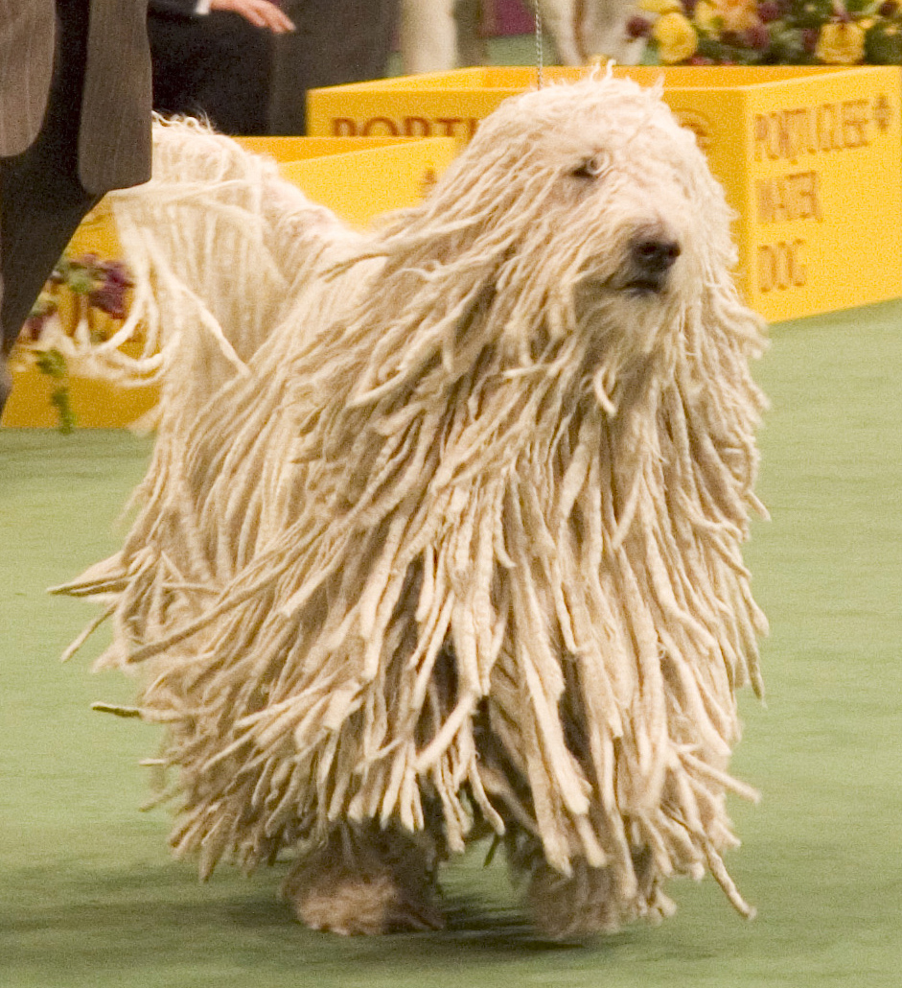

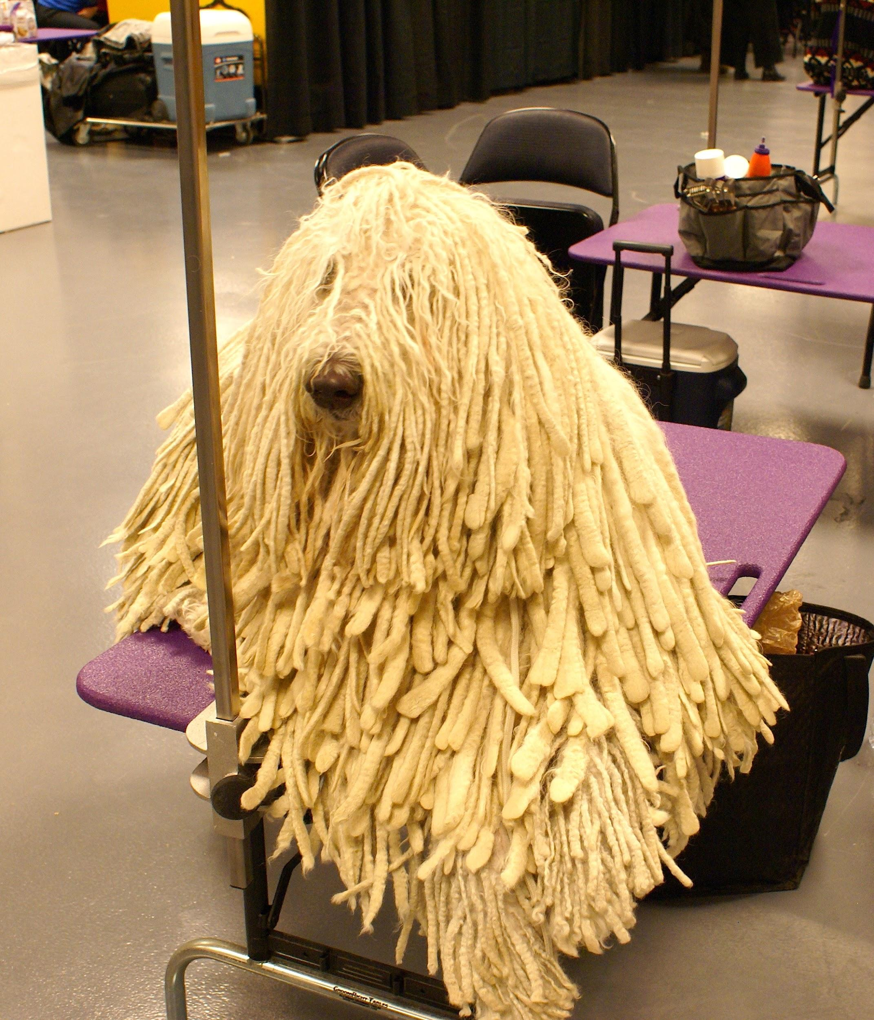

Not so fast...
CC-BY-SA-2.5 Wikimedia Commons https://commons.wikimedia.org/wiki/File:Komondor_Westminster_Dog_Show_crop.jpg
CC-BY-2.0 Wikimedia Commons https://commons.wikimedia.org/wiki/File:2014_Westminster_Kennel_Club_Dog_Show_(12487315865).jpg

Slide 5
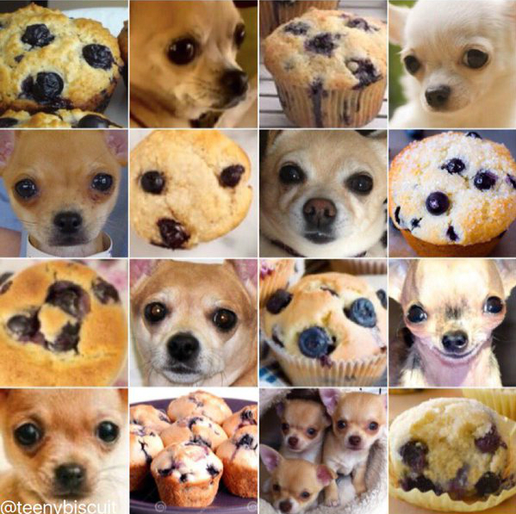
Not so fast...
CC-BY-SA-2.5 Wikimedia Commons https://commons.wikimedia.org/wiki/File:Komondor_Westminster_Dog_Show_crop.jpg
CC-BY-2.0 Wikimedia Commons https://commons.wikimedia.org/wiki/File:2014_Westminster_Kennel_Club_Dog_Show_(12487315865).jpg

Slide 6
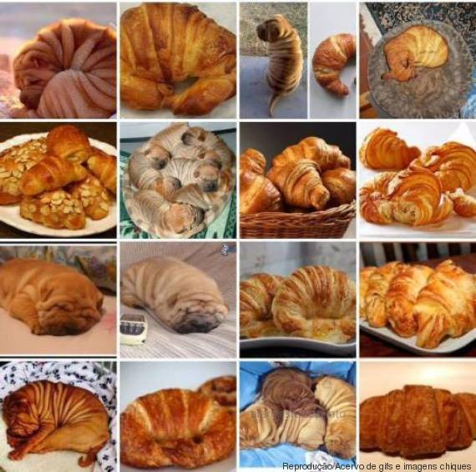
Not so fast...
CC-BY-SA-2.5 Wikimedia Commons https://commons.wikimedia.org/wiki/File:Komondor_Westminster_Dog_Show_crop.jpg
CC-BY-2.0 Wikimedia Commons https://commons.wikimedia.org/wiki/File:2014_Westminster_Kennel_Club_Dog_Show_(12487315865).jpg

Slide 7
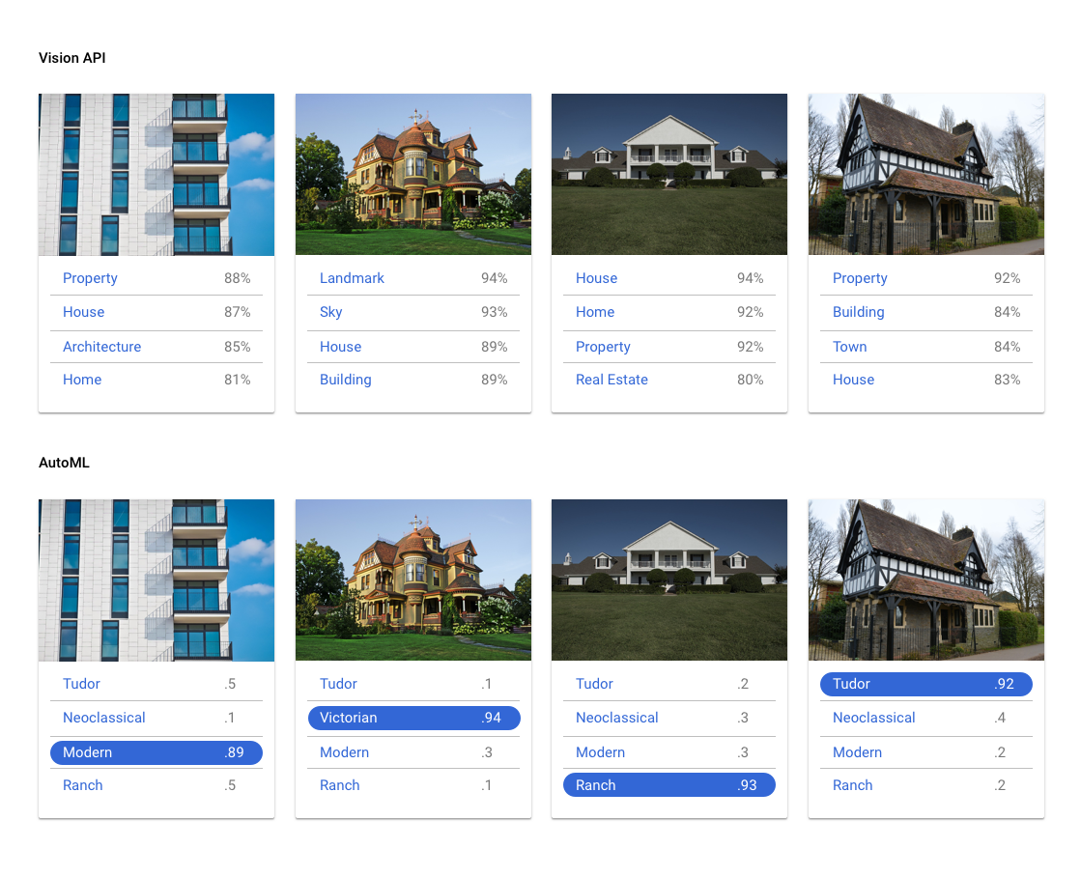
Make or Buy
API
Custom

Slide 8



Convolution Neural Network (CNN)
Vinicius F. Caridá

Slide 9
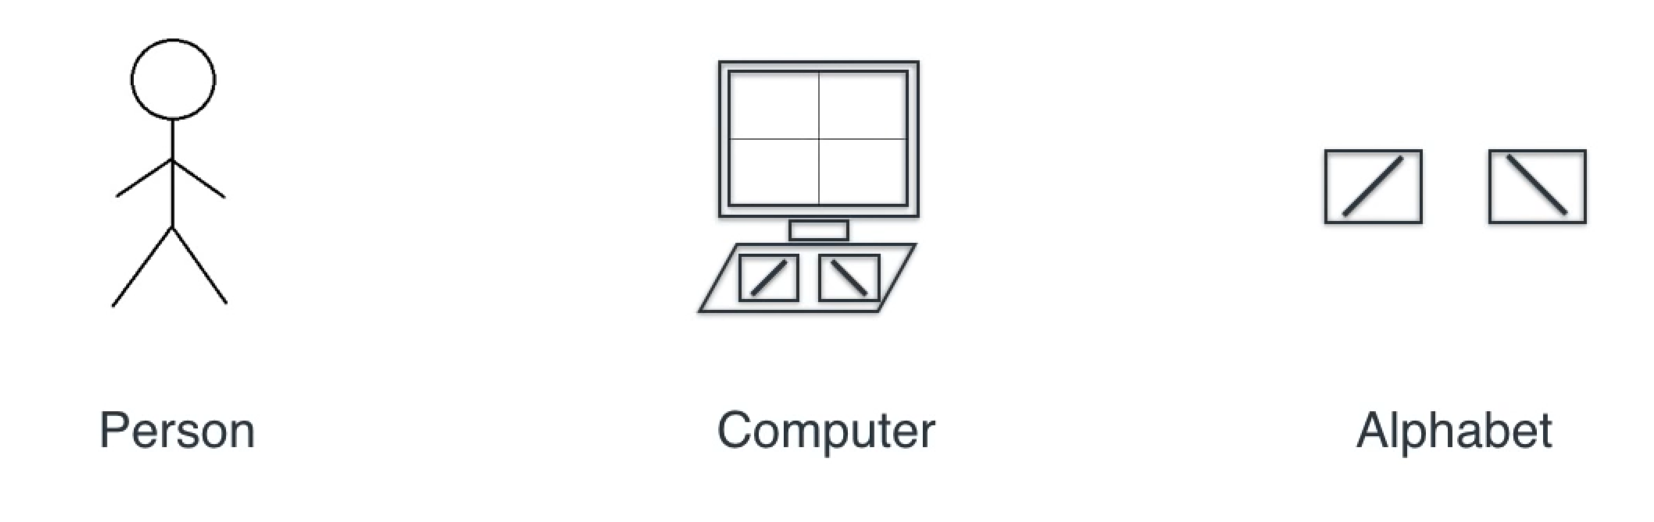
Convolution Neural Network (CNN)
A simple world

Slide 10
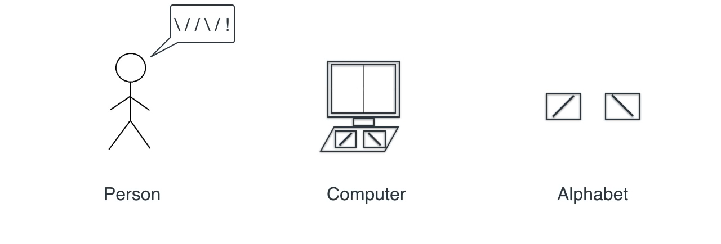
Convolution Neural Network (CNN)
A simple world

Slide 11
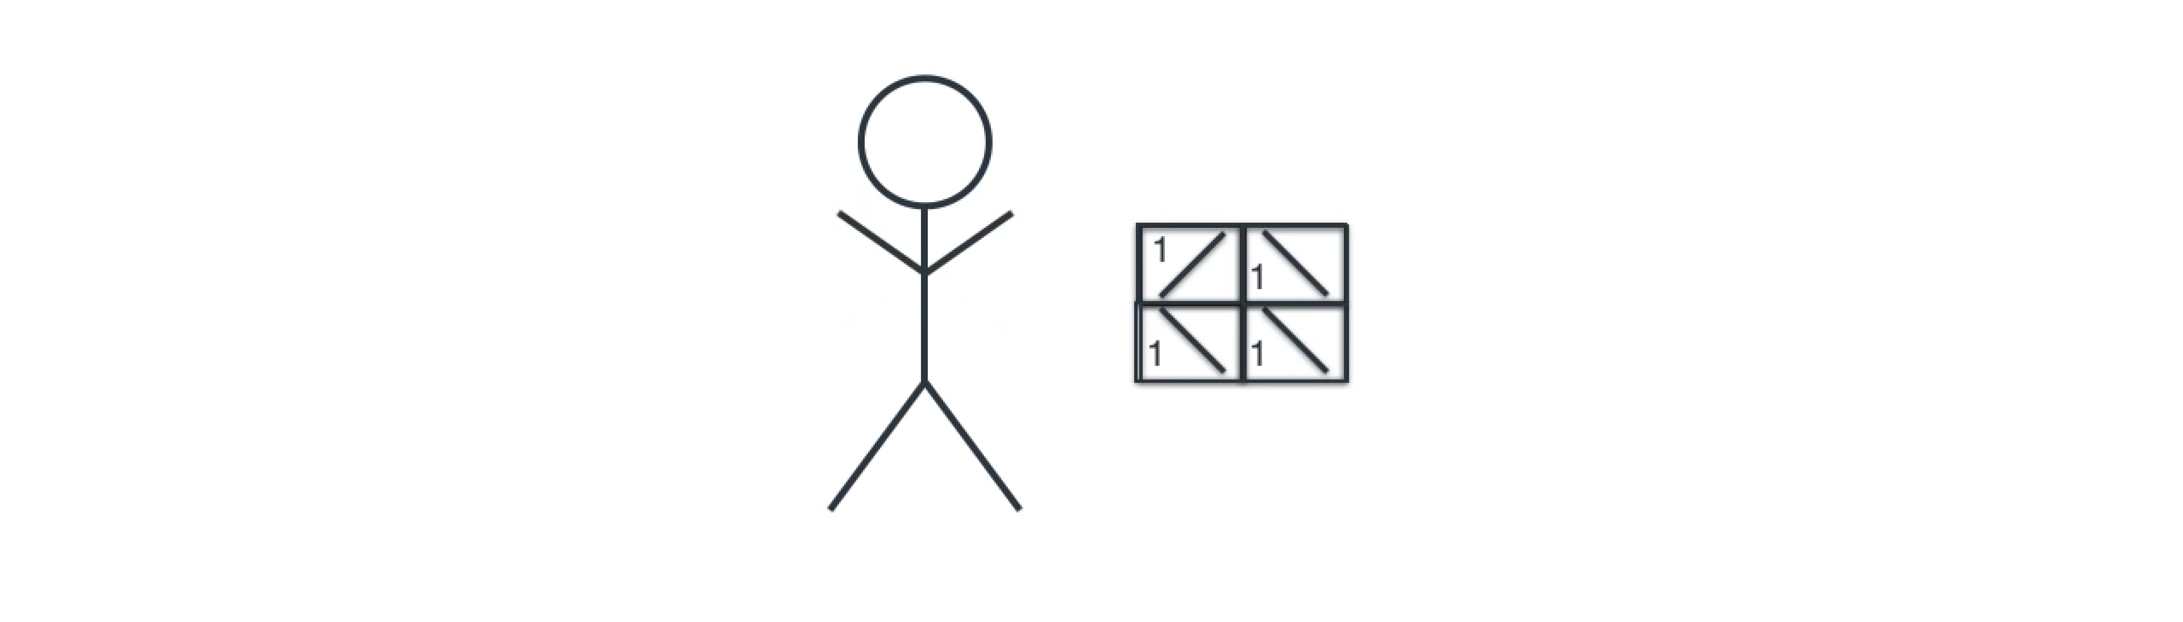
Convolution Neural Network (CNN)
A simple world

Slide 12
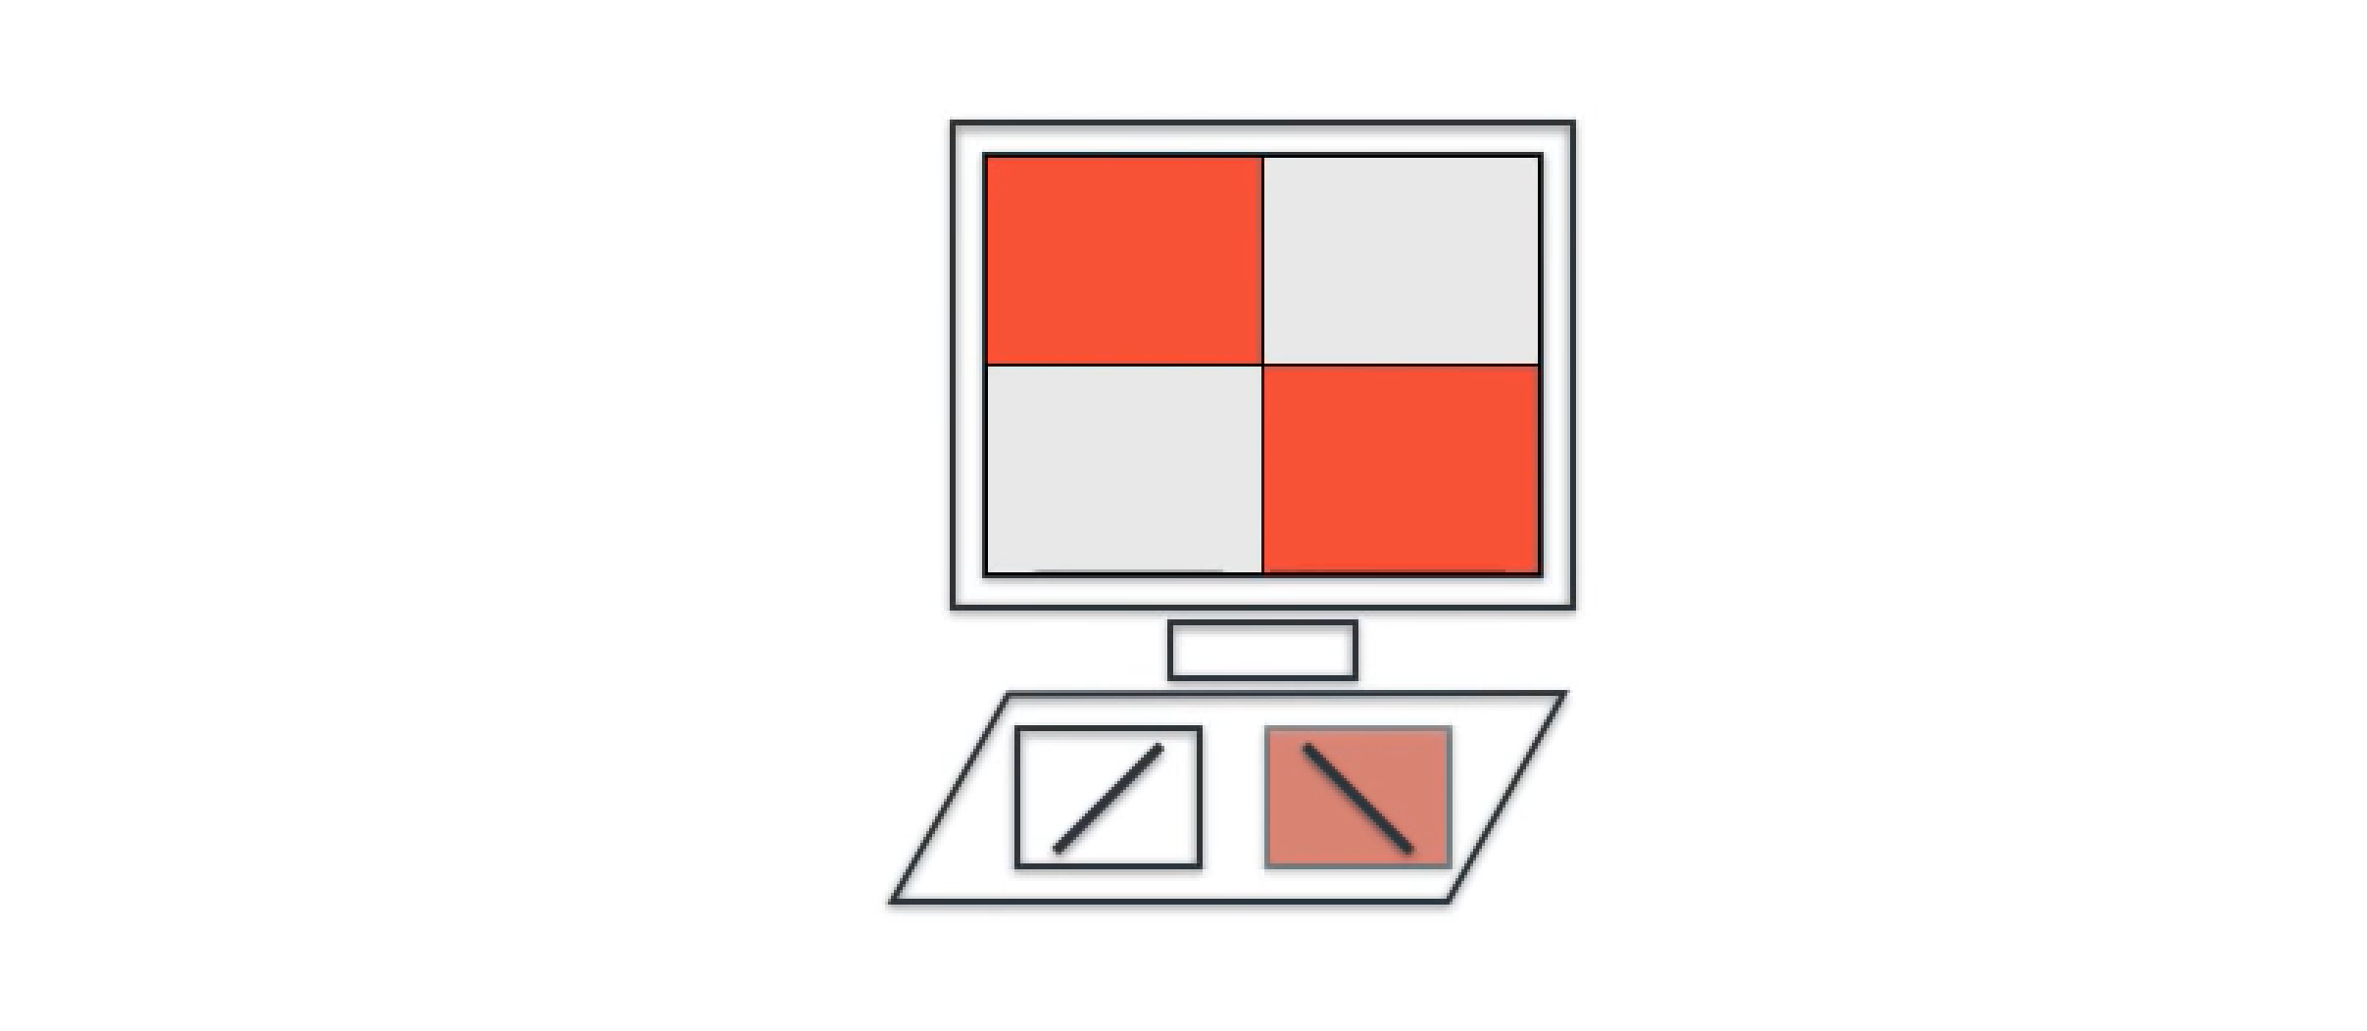
Convolution Neural Network (CNN)
A simple world

Slide 13
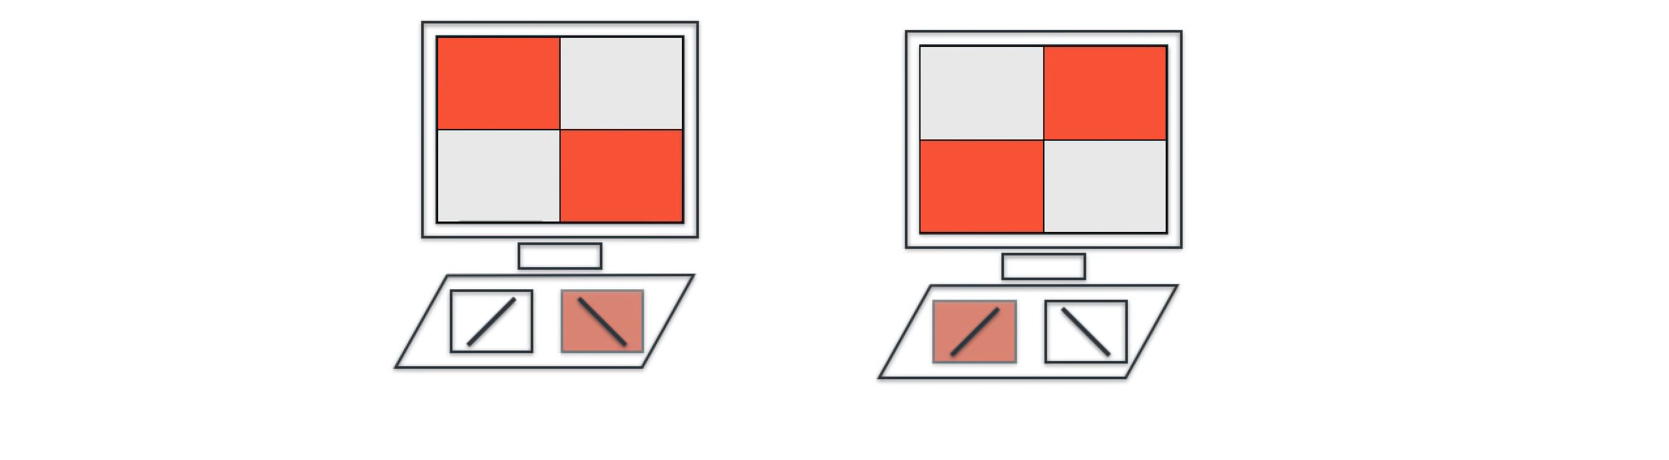
Convolution Neural Network (CNN)
A simple world

Slide 14
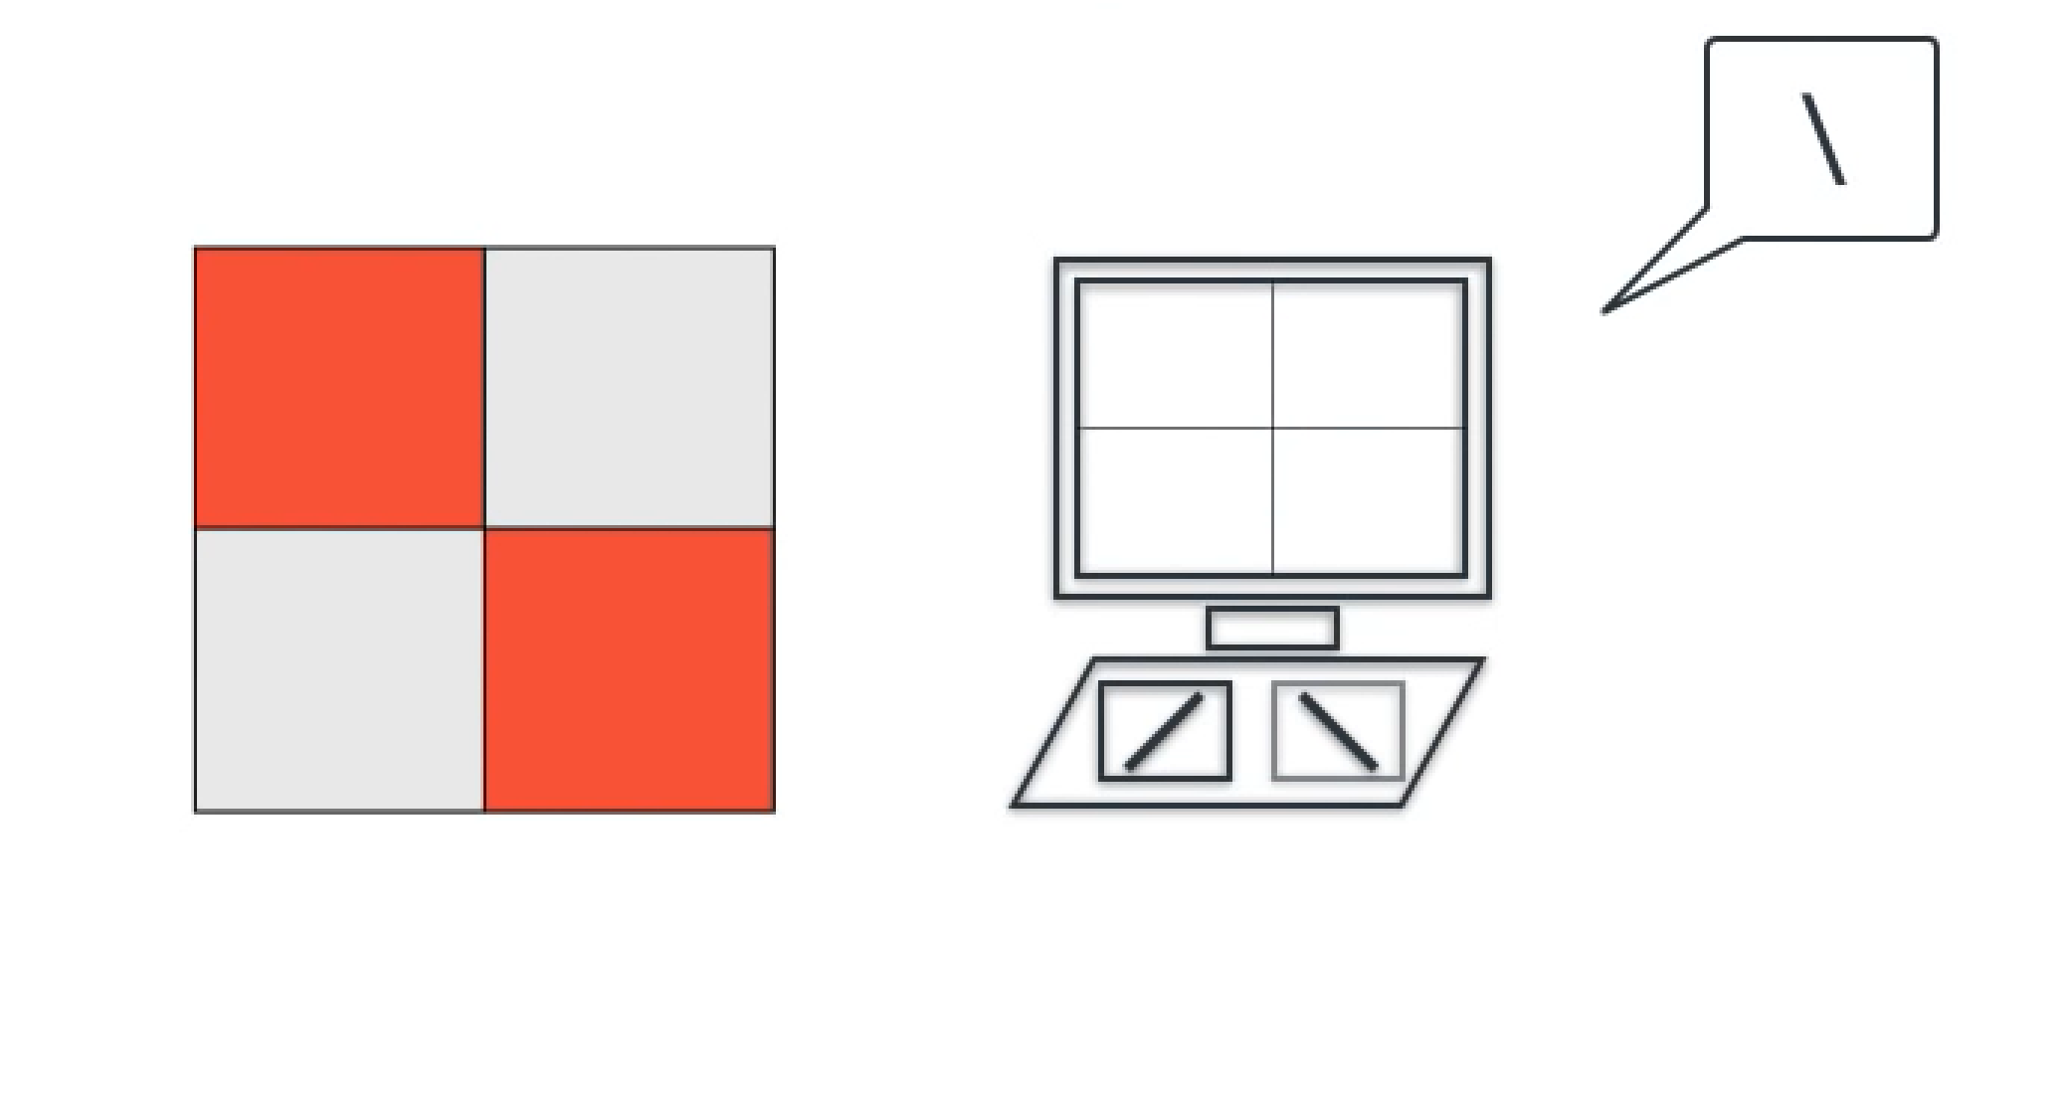
Convolution Neural Network (CNN)
A simple world

Slide 15
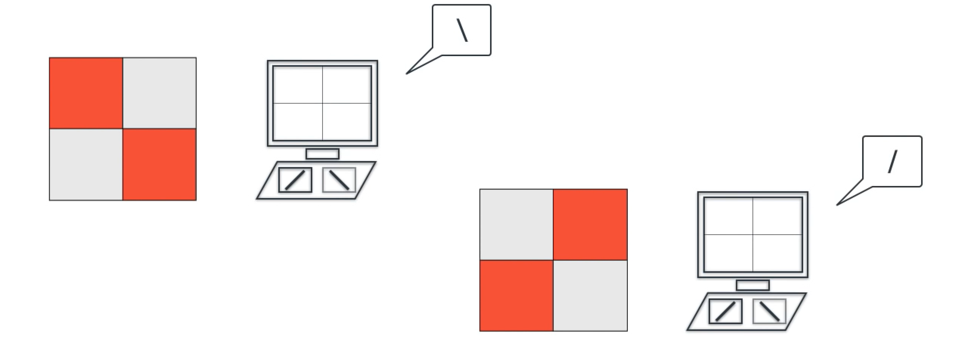
Convolution Neural Network (CNN)
A simple world

Slide 16
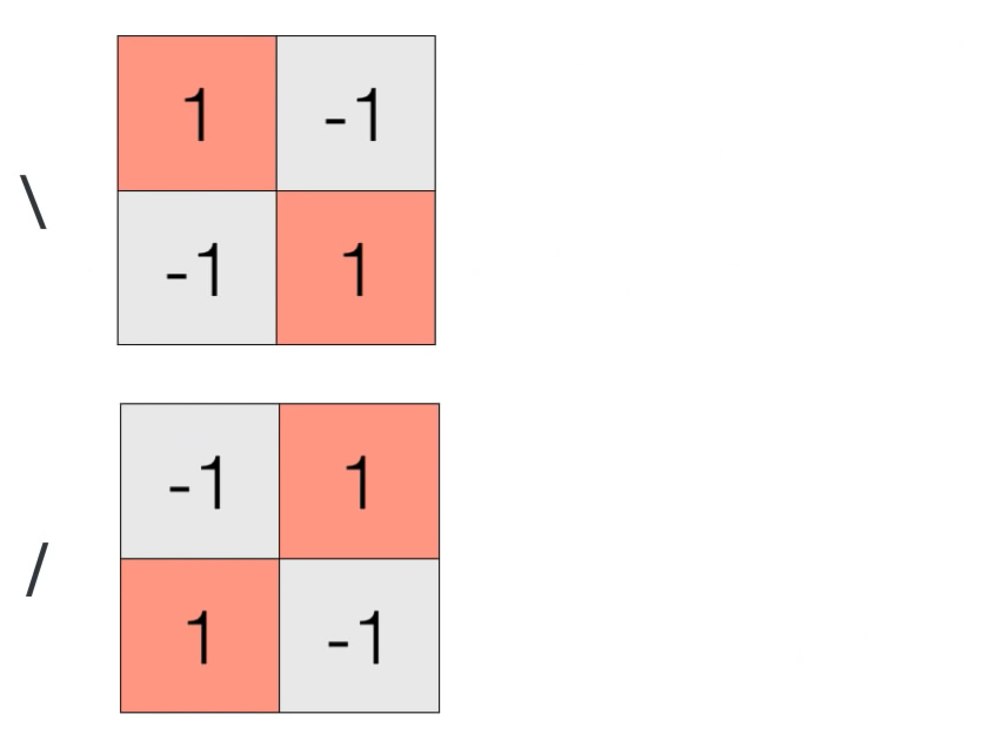
Convolution Neural Network (CNN)
A simple world

Slide 17
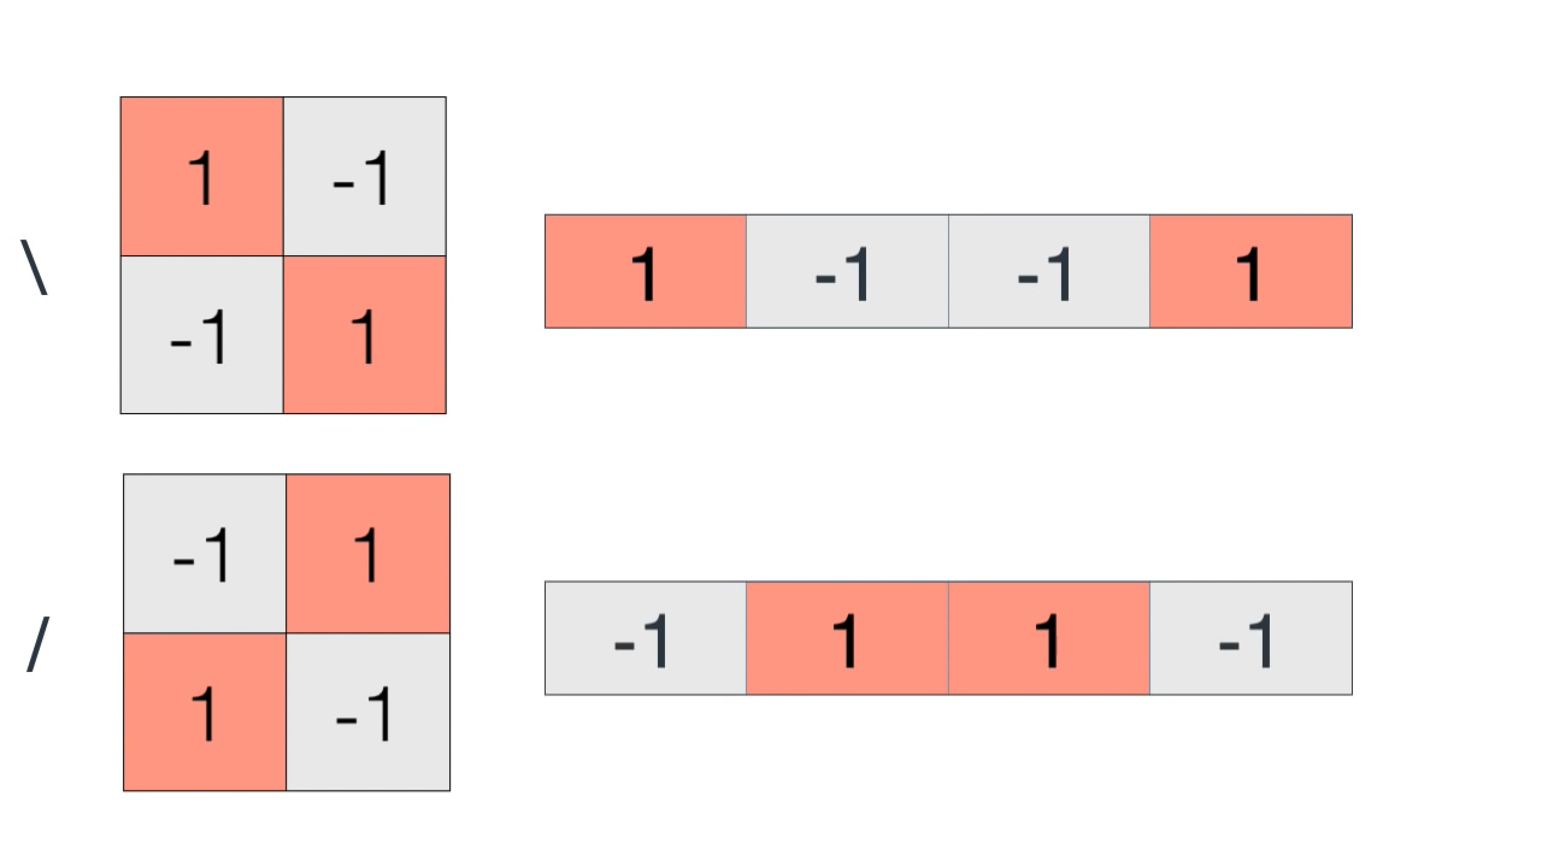
Convolution Neural Network (CNN)
A simple world

Slide 18
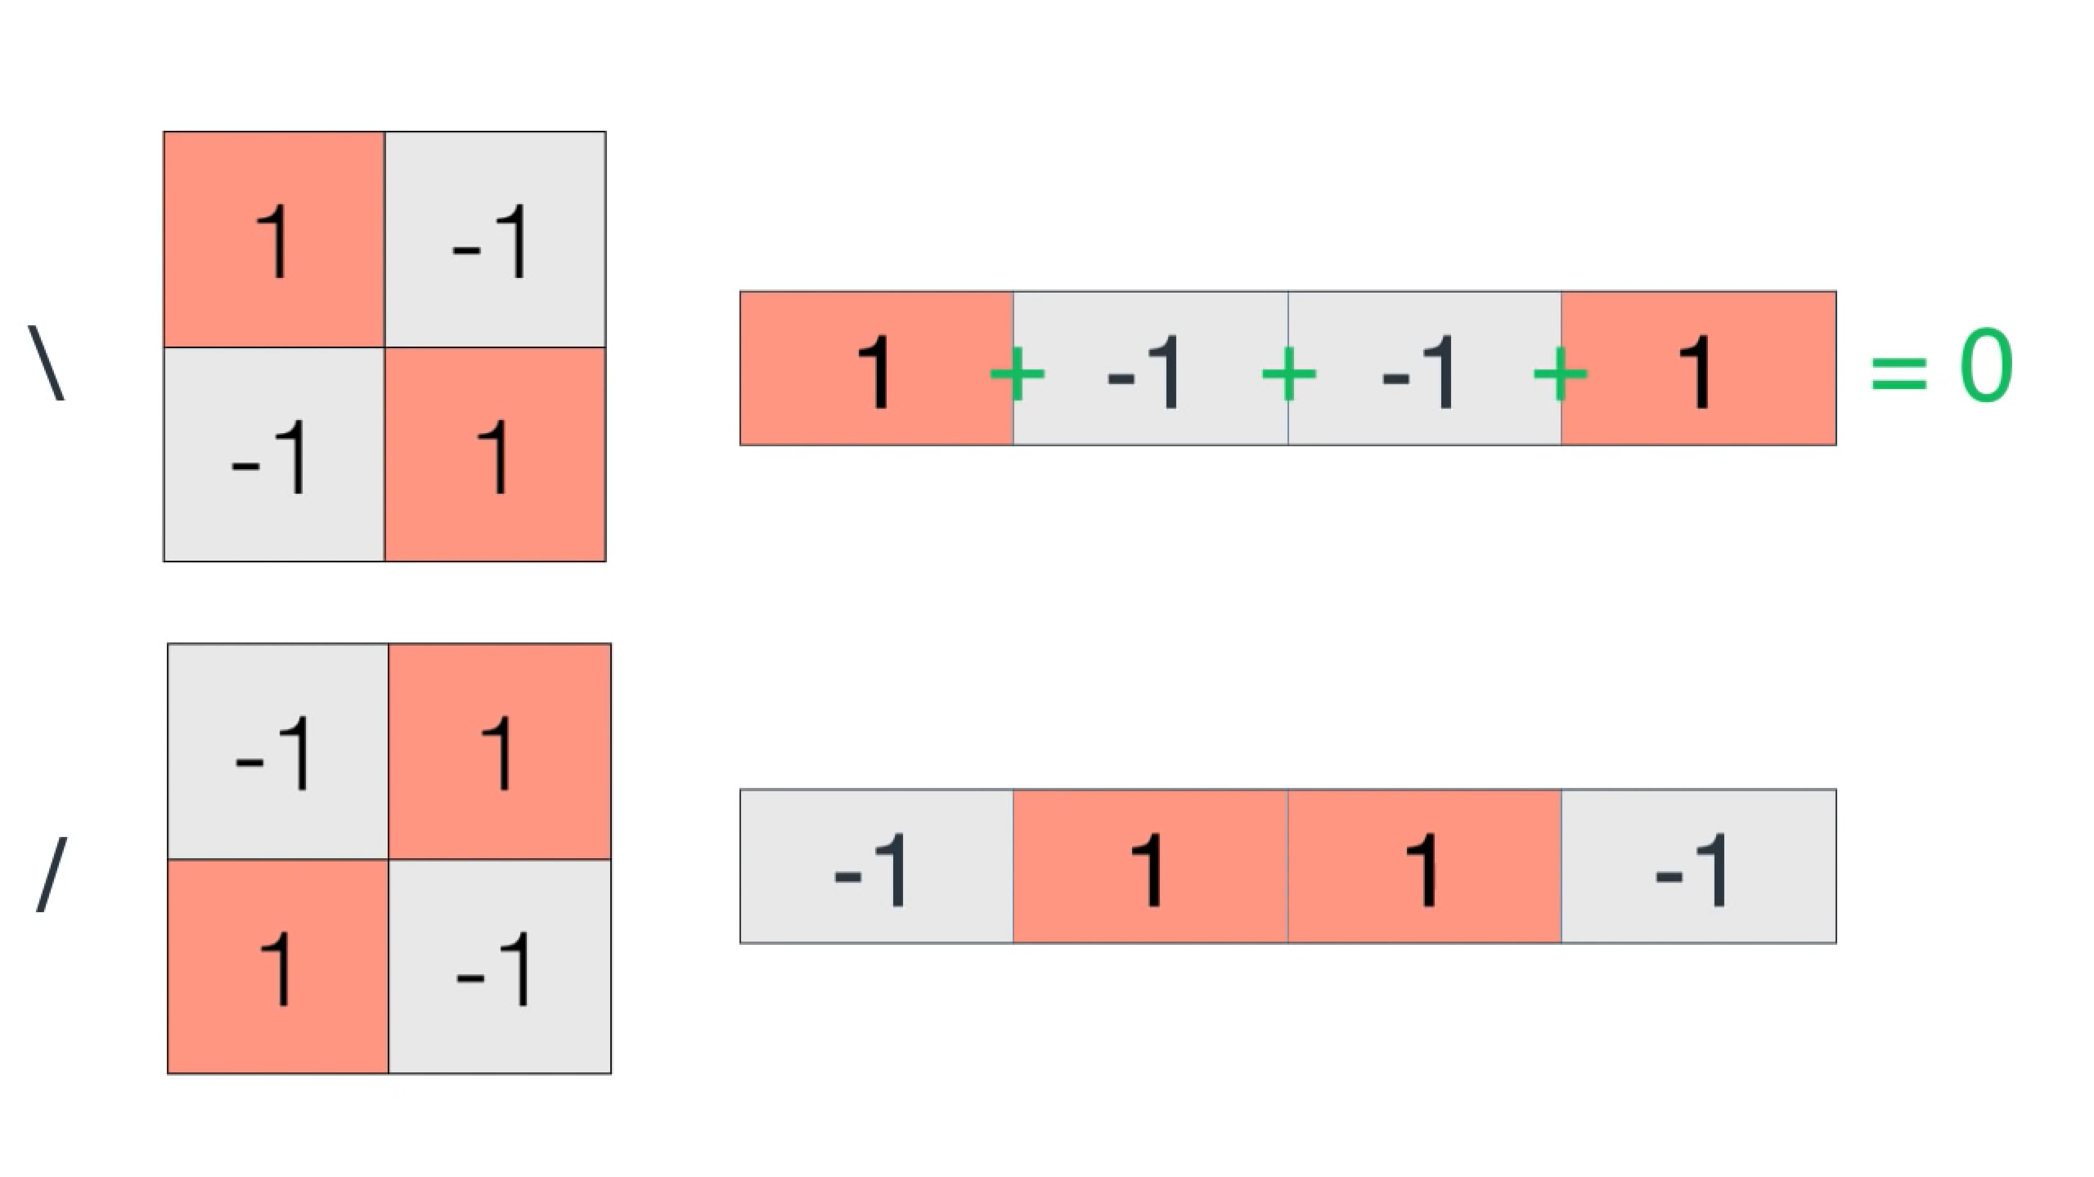
Convolution Neural Network (CNN)
A simple world

Slide 19
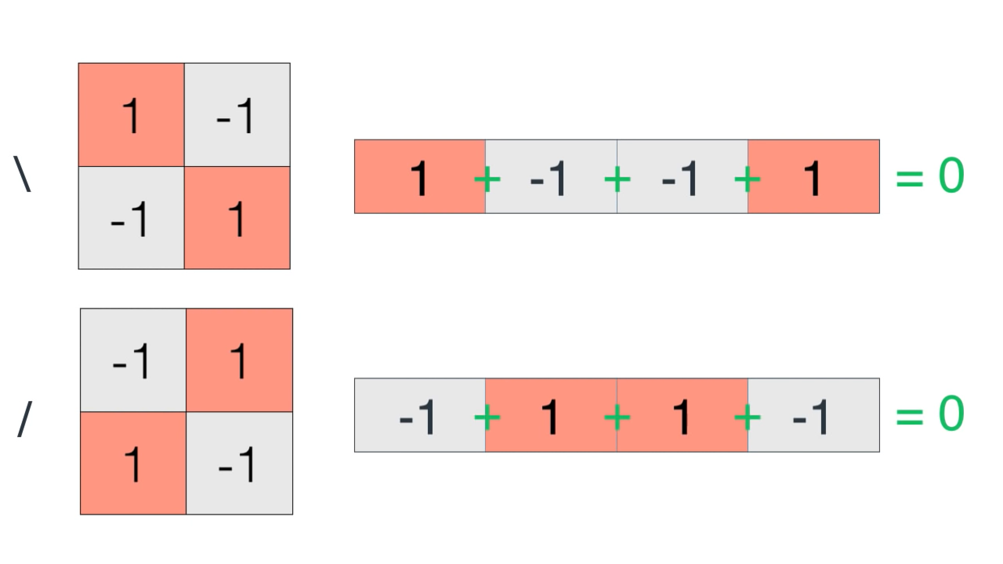
Convolution Neural Network (CNN)
A simple world

Slide 20

Convolution Neural Network (CNN)
A simple world

Slide 21

Convolution Neural Network (CNN)
A simple world

Slide 22

Convolution Neural Network (CNN)
A simple world

Slide 23
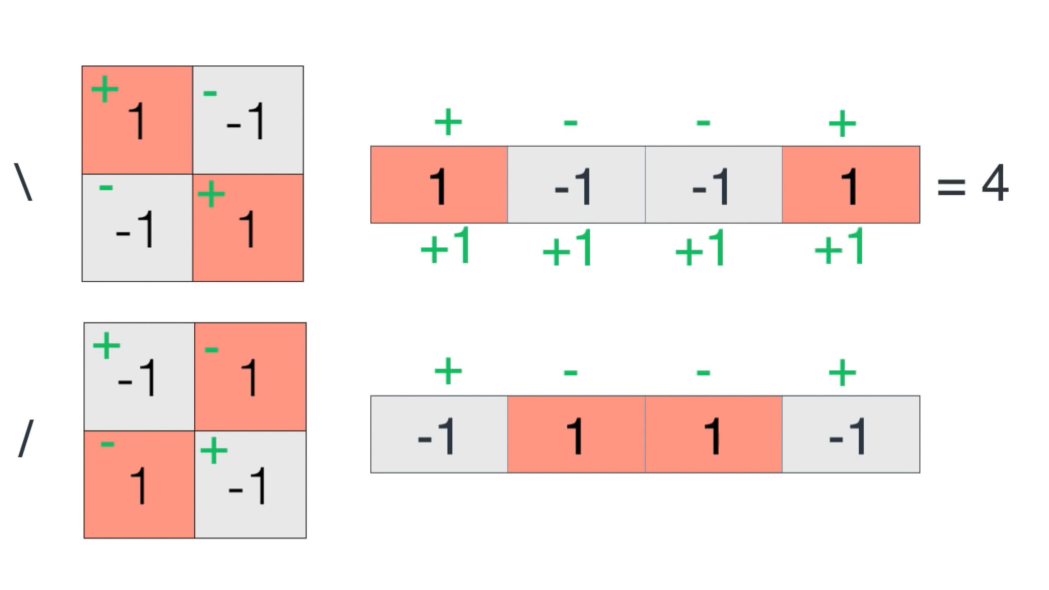
Convolution Neural Network (CNN)
A simple world

Slide 24
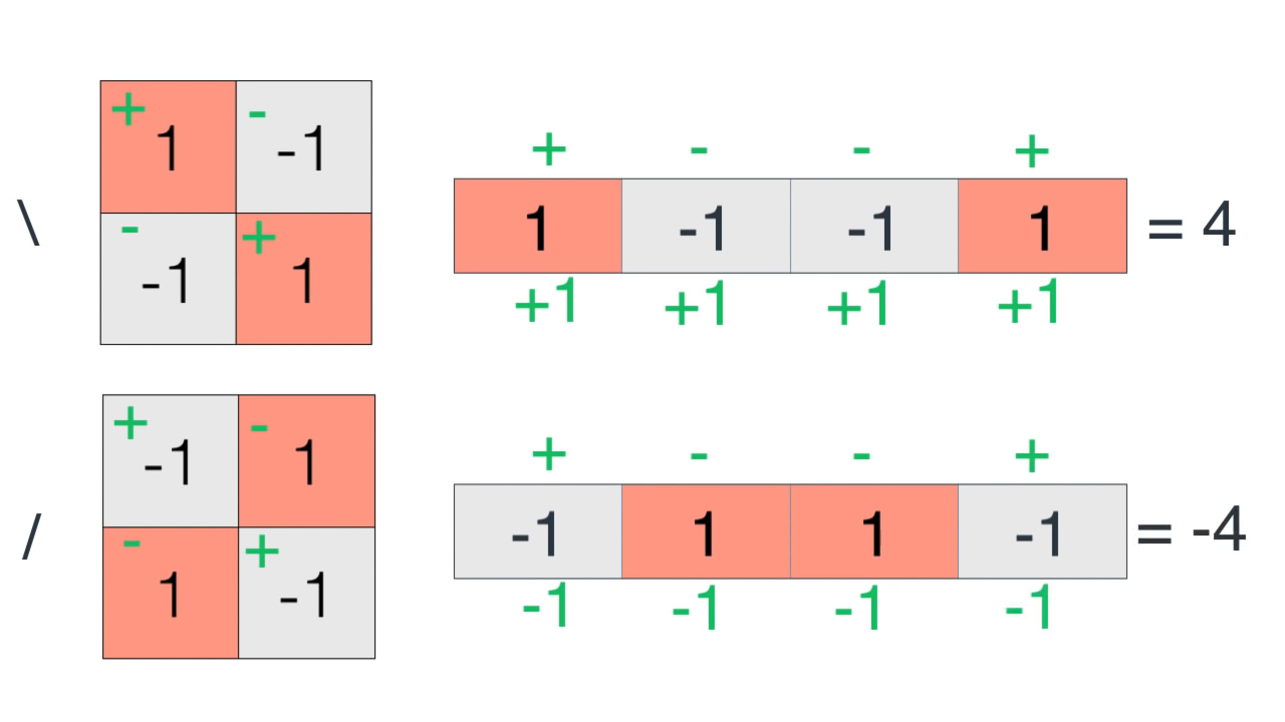
Convolution Neural Network (CNN)
A simple world

Slide 25
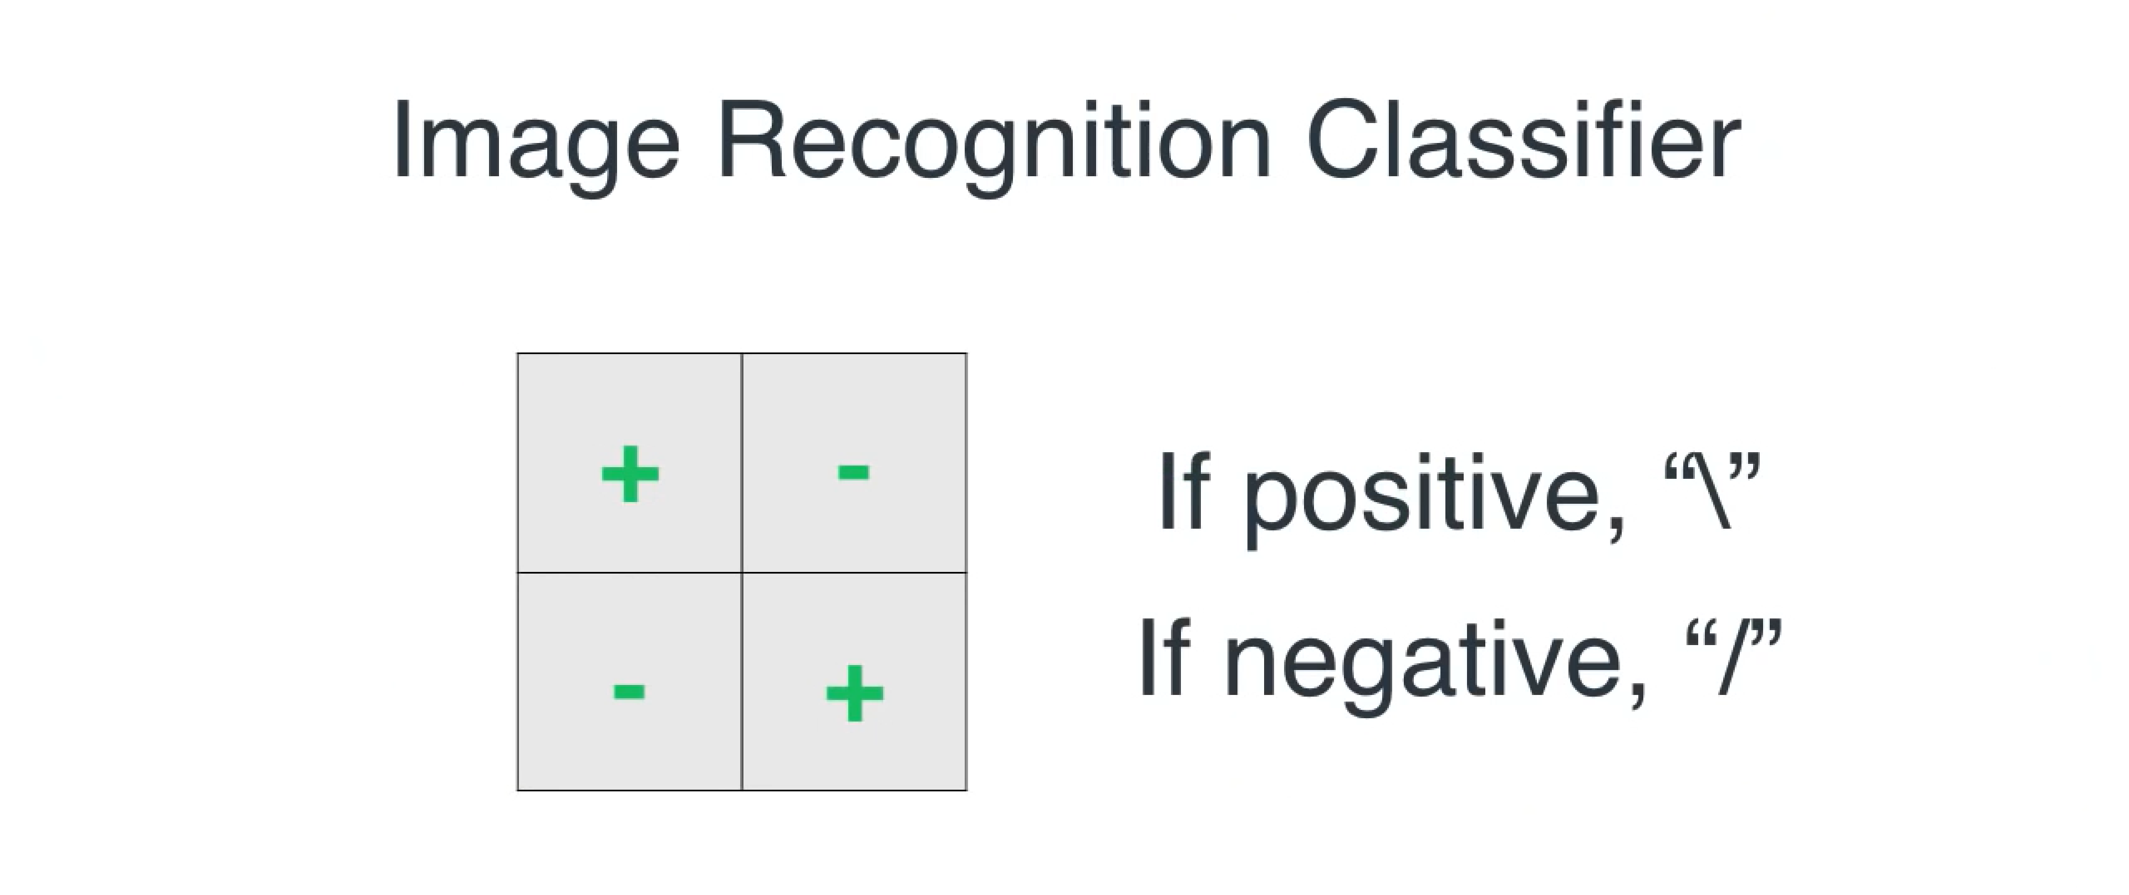
Convolution Neural Network (CNN)
A simple world

Slide 26
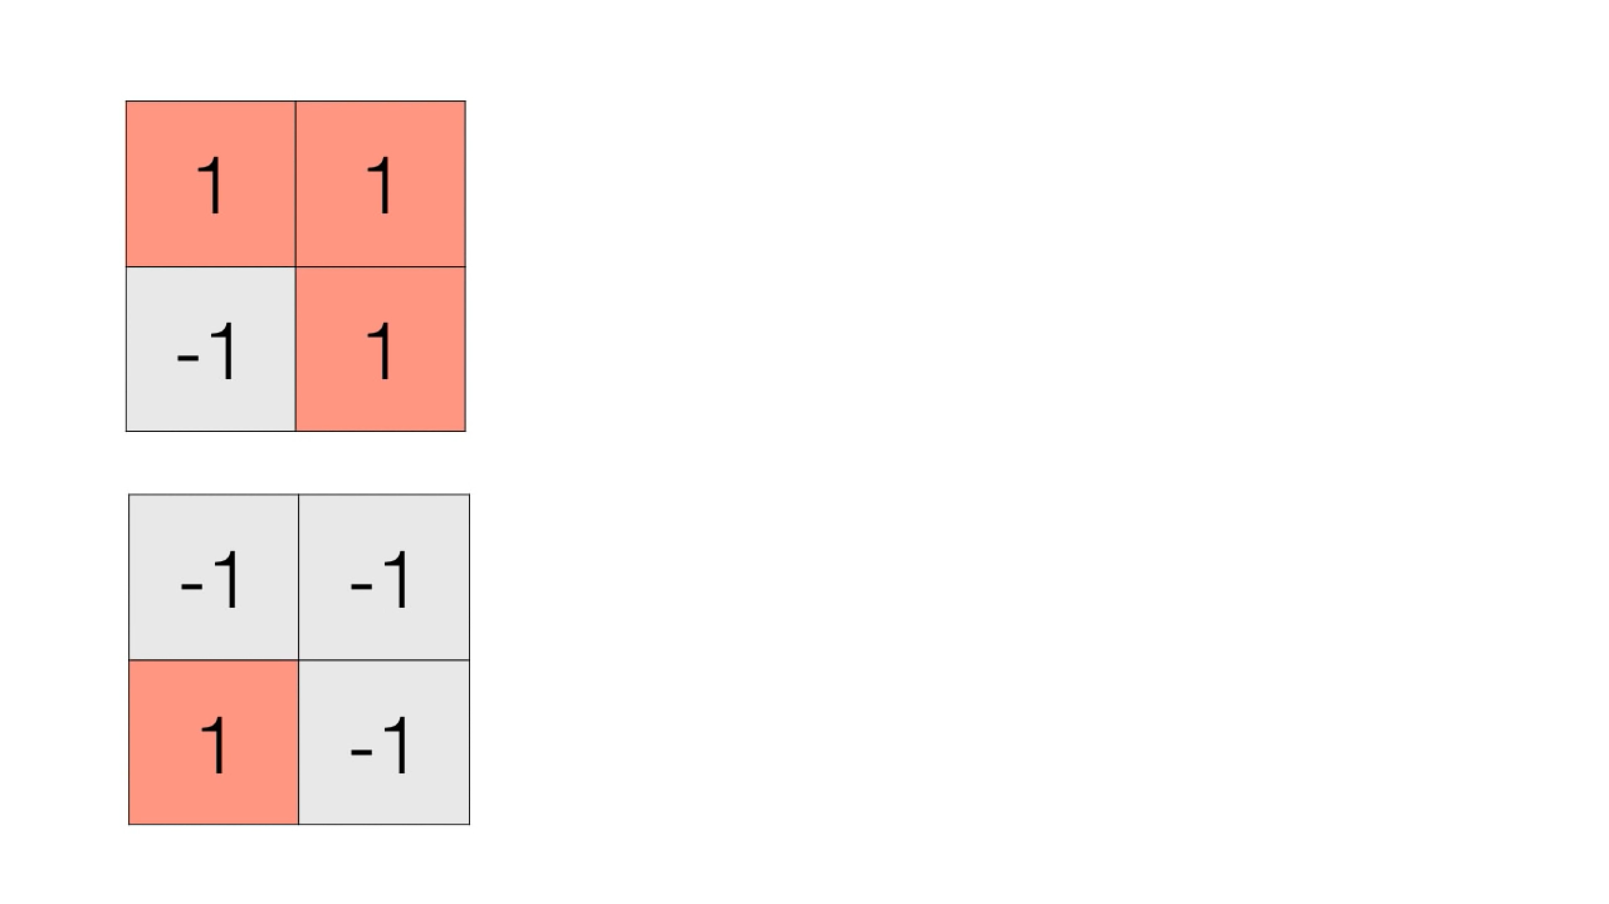
Convolution Neural Network (CNN)
A simple world

Slide 27
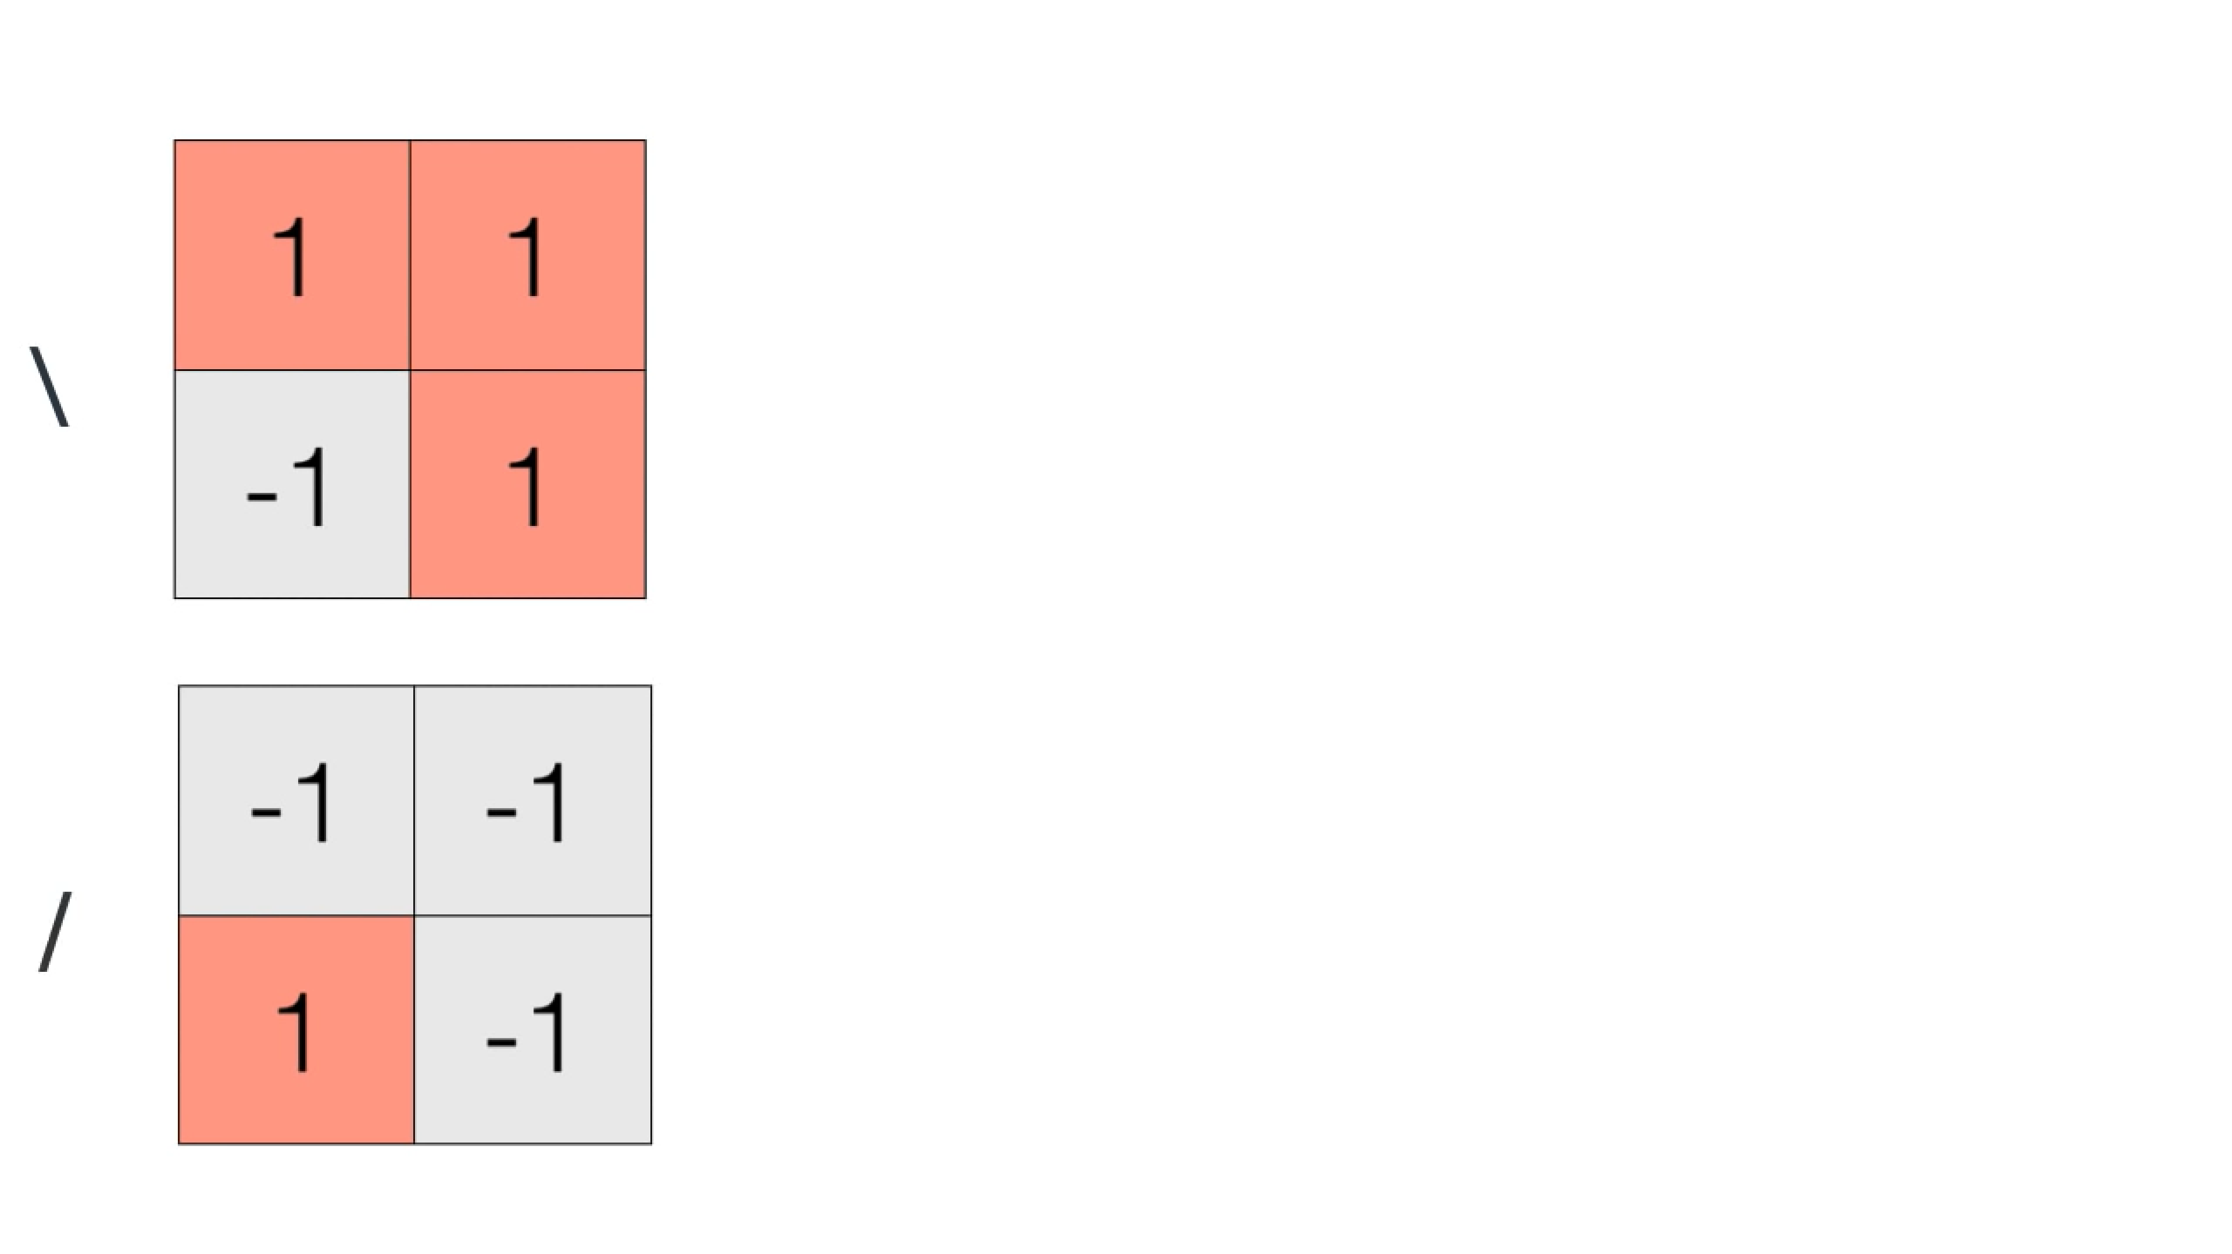
Convolution Neural Network (CNN)
A simple world

Slide 28
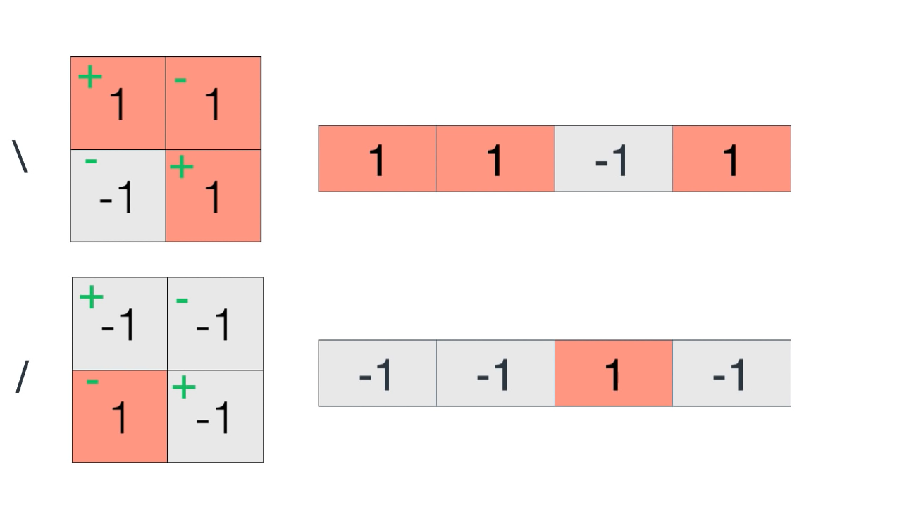
Convolution Neural Network (CNN)
A simple world

Slide 29

Convolution Neural Network (CNN)
A simple world

Slide 30

Convolution Neural Network (CNN)
A simple world

Slide 31
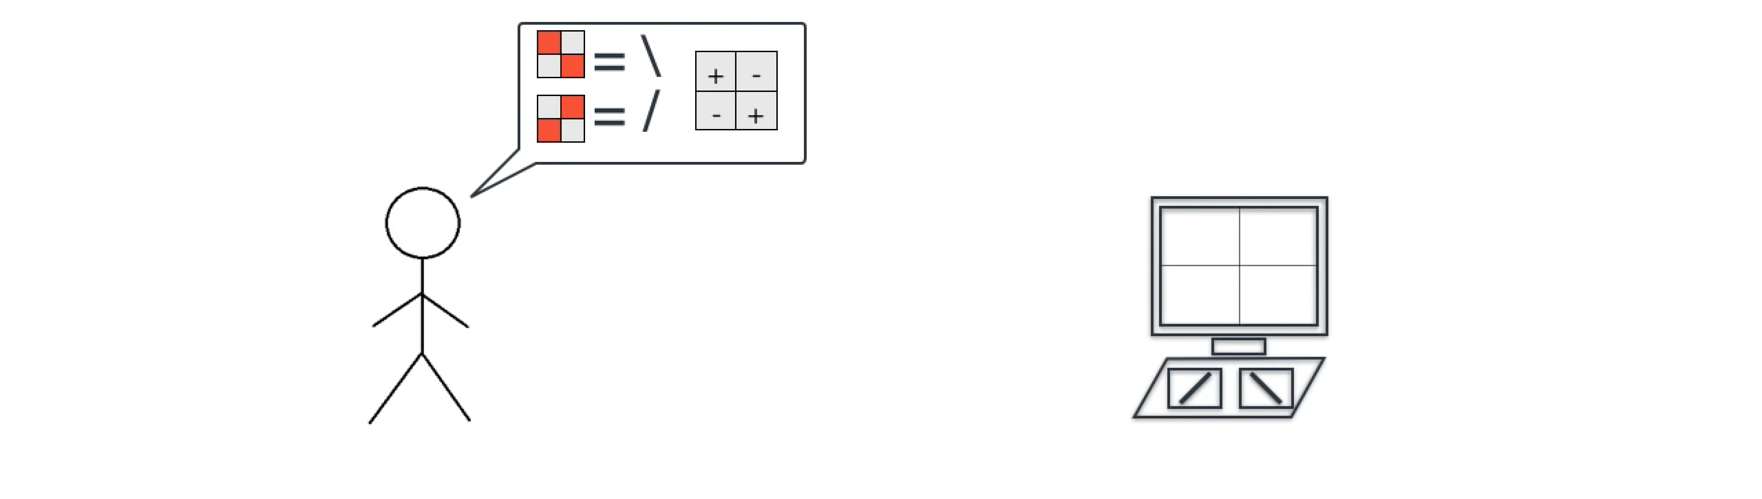
Convolution Neural Network (CNN)
A simple world

Slide 32
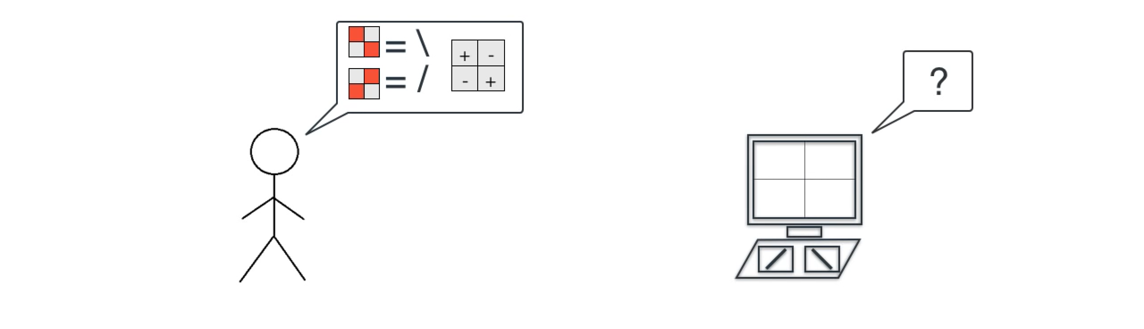
Convolution Neural Network (CNN)
A simple world

Slide 33
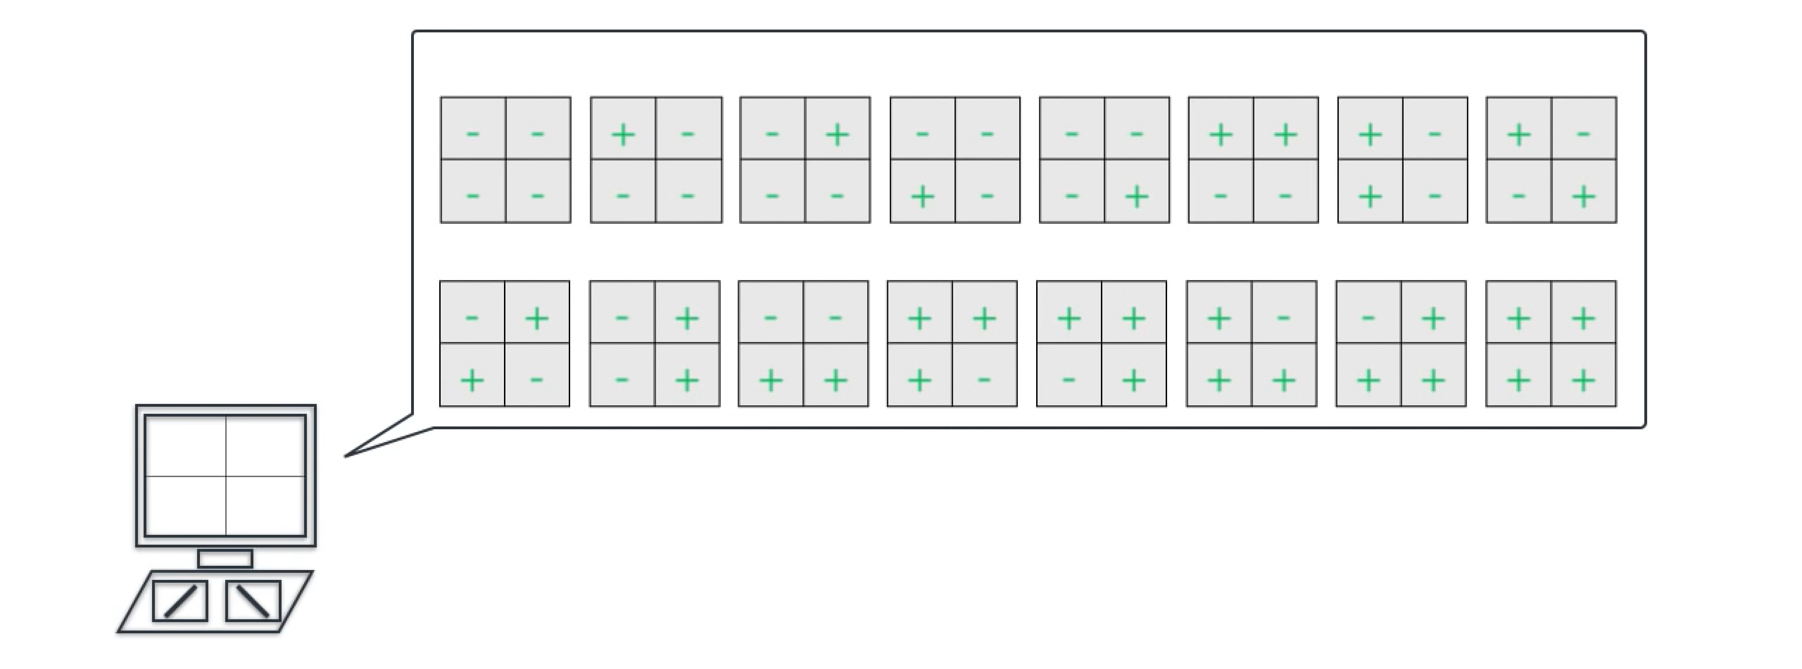
Convolution Neural Network (CNN)
A simple world

Slide 34
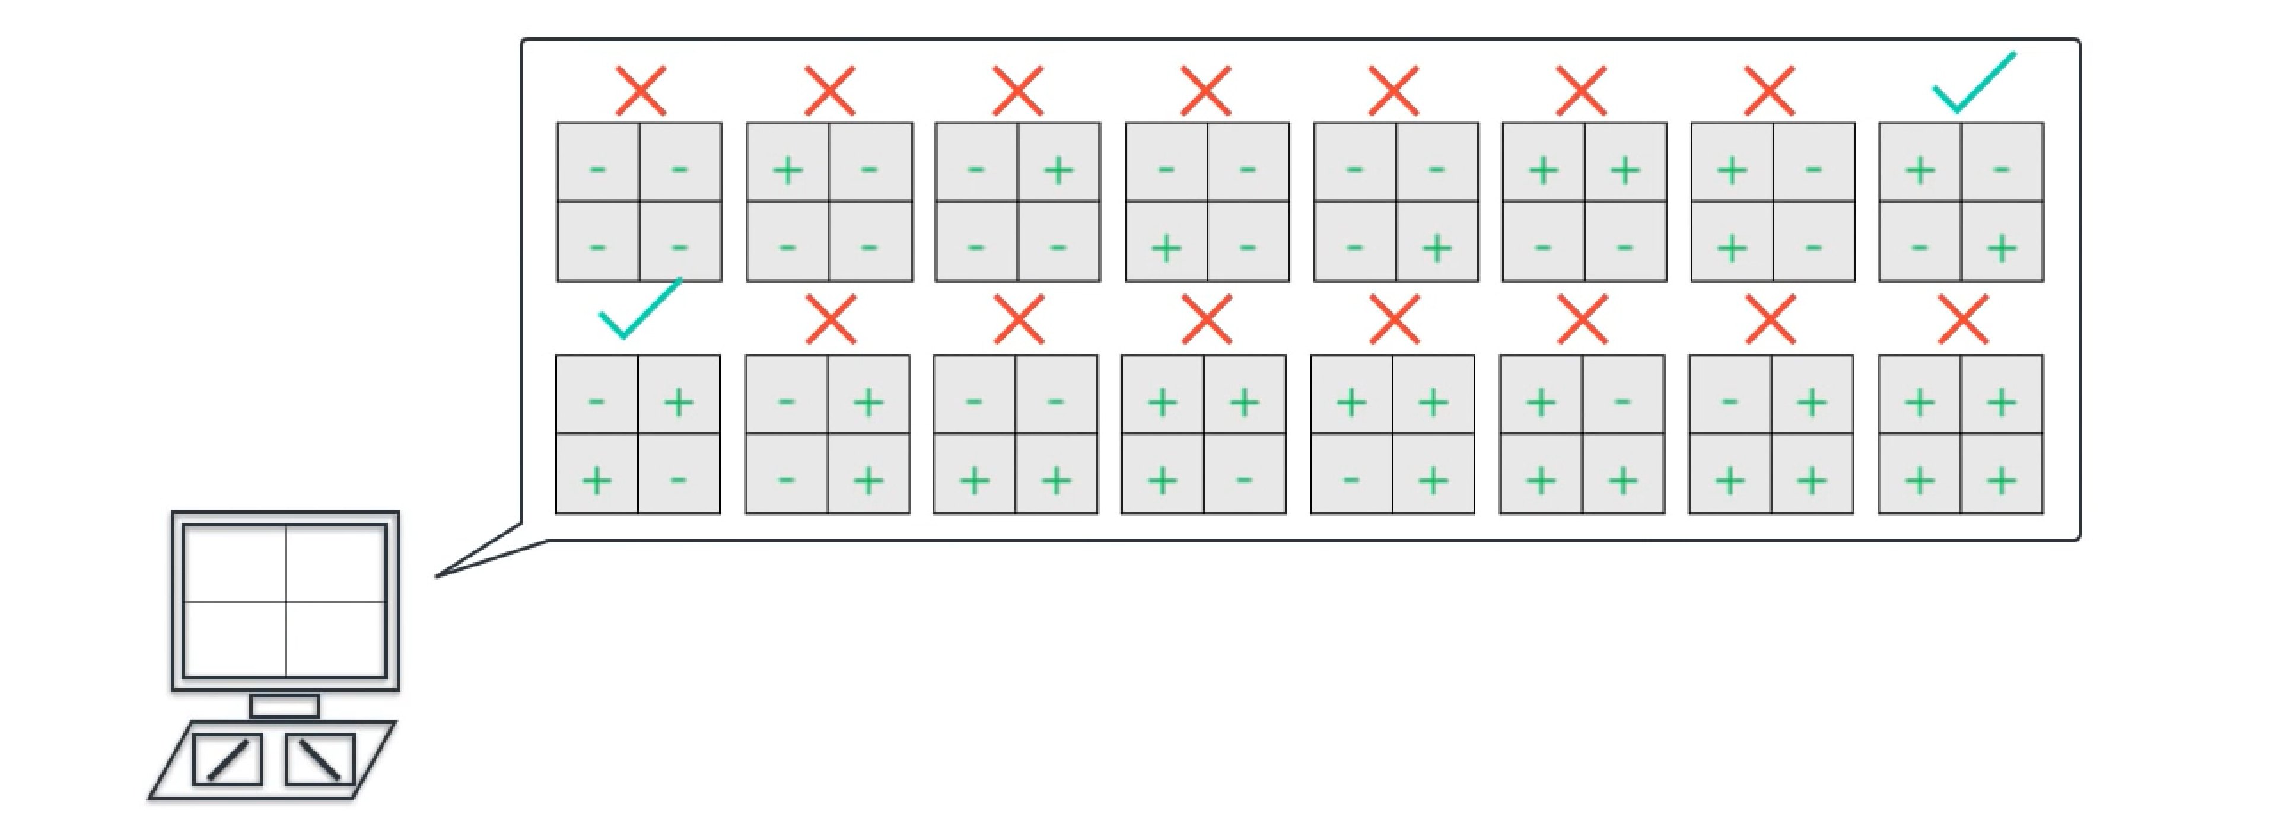
Convolution Neural Network (CNN)
A simple world

Slide 35
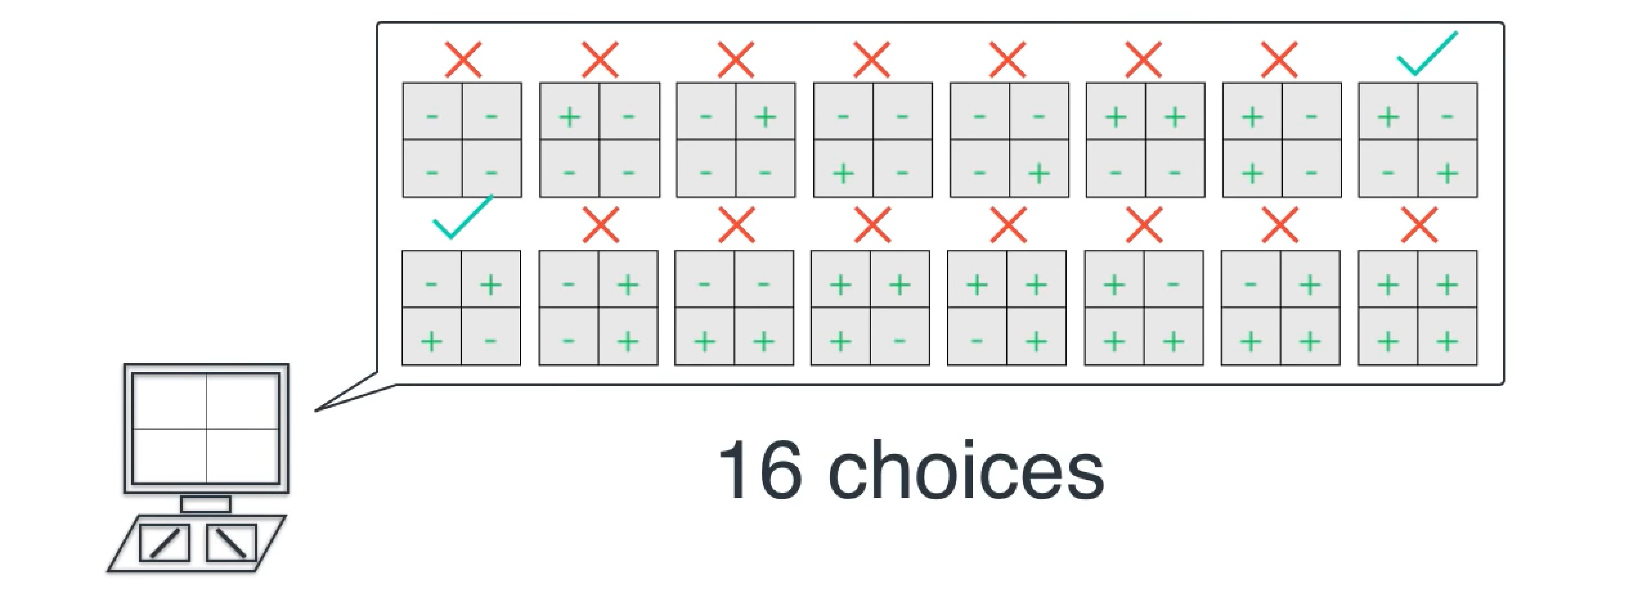
Convolution Neural Network (CNN)
A simple world

Slide 36
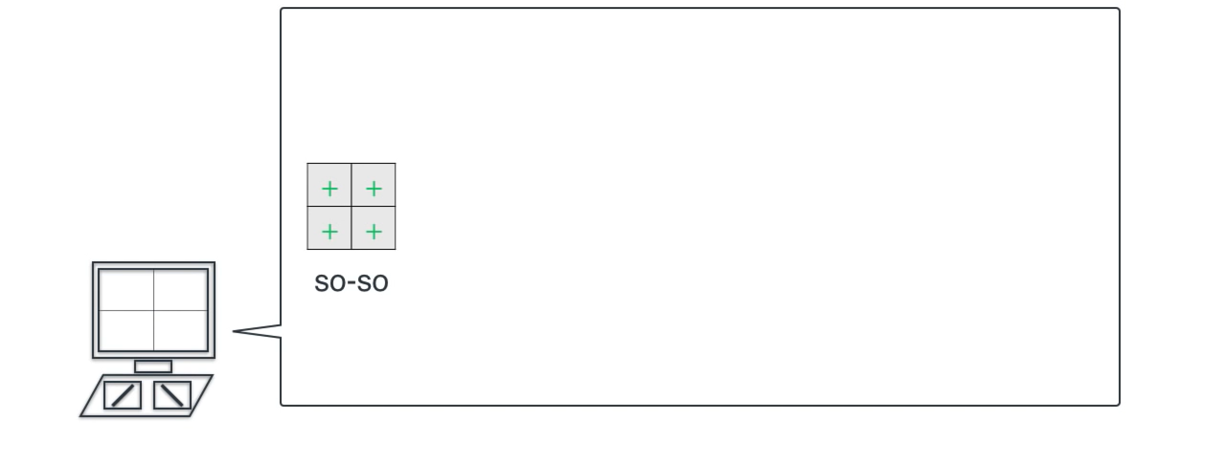
Convolution Neural Network (CNN)
A simple world

Slide 37
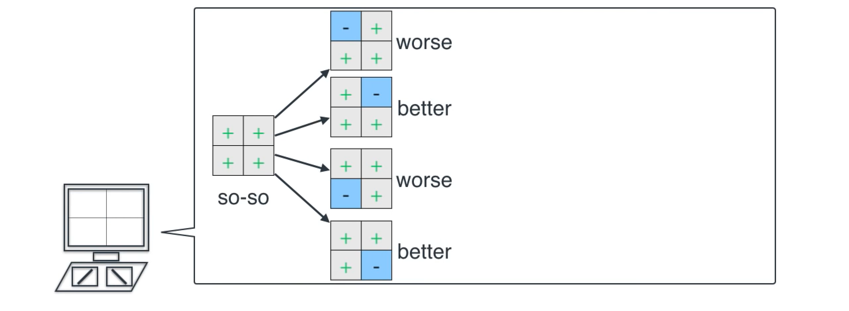
Convolution Neural Network (CNN)
A simple world

Slide 38
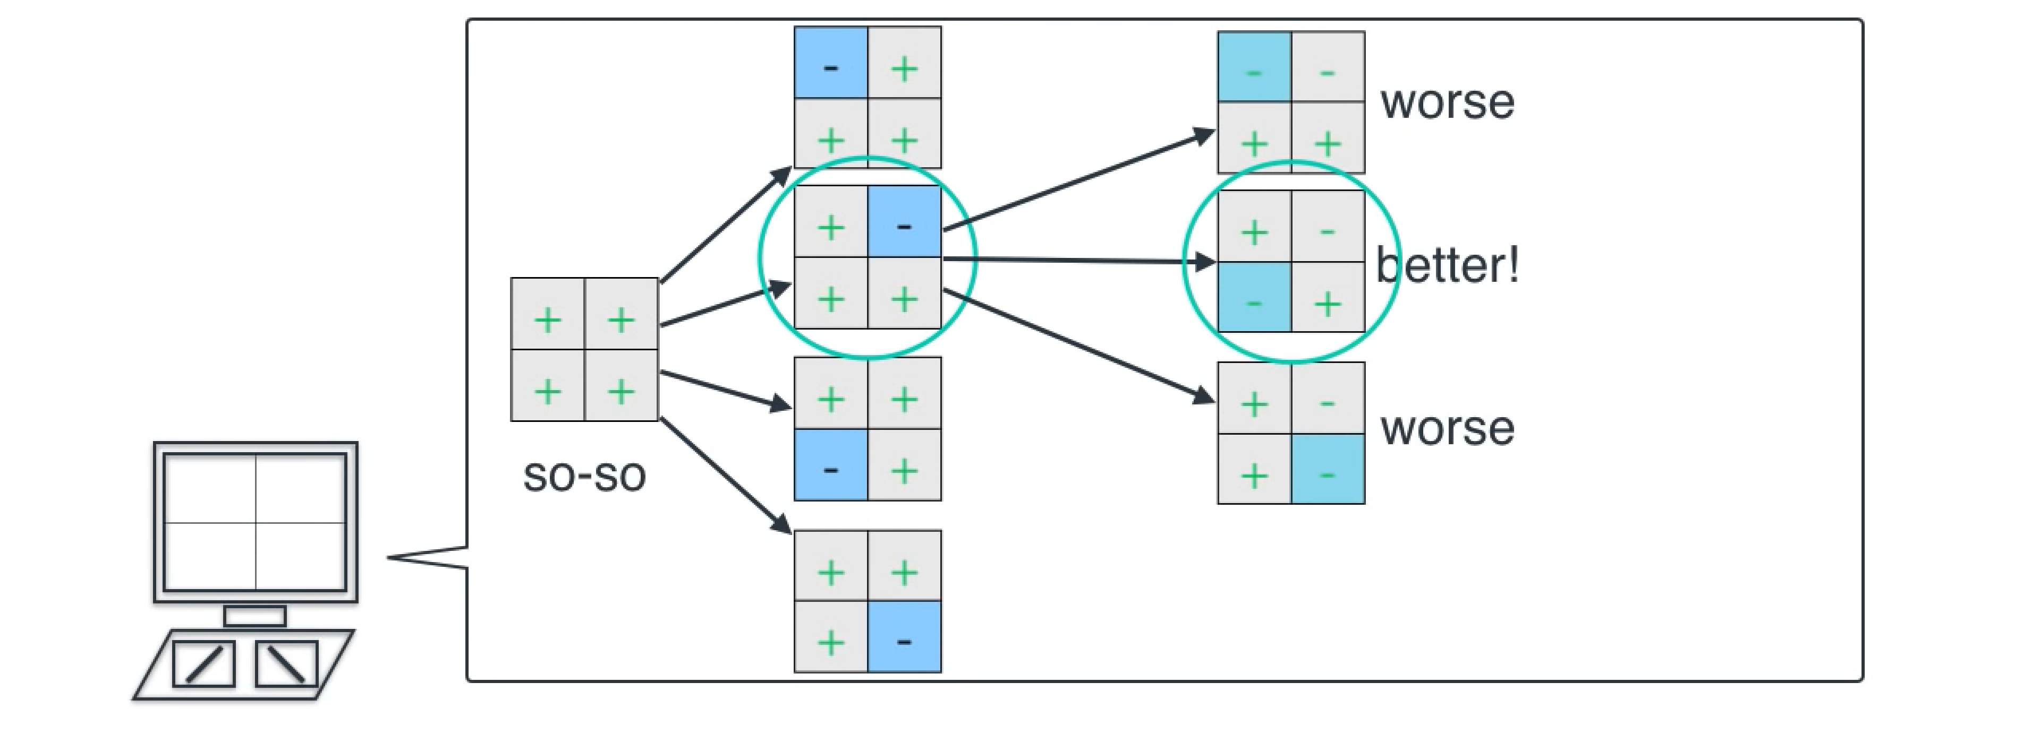
Convolution Neural Network (CNN)
A simple world

Slide 39
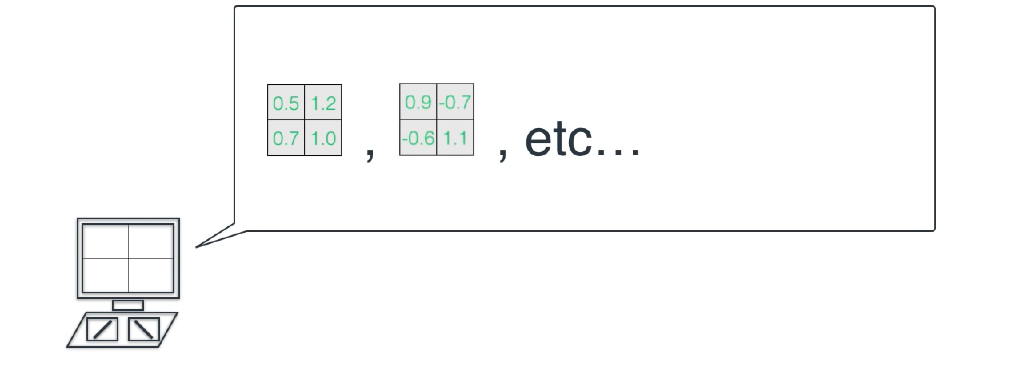
Convolution Neural Network (CNN)
A simple world

Slide 40
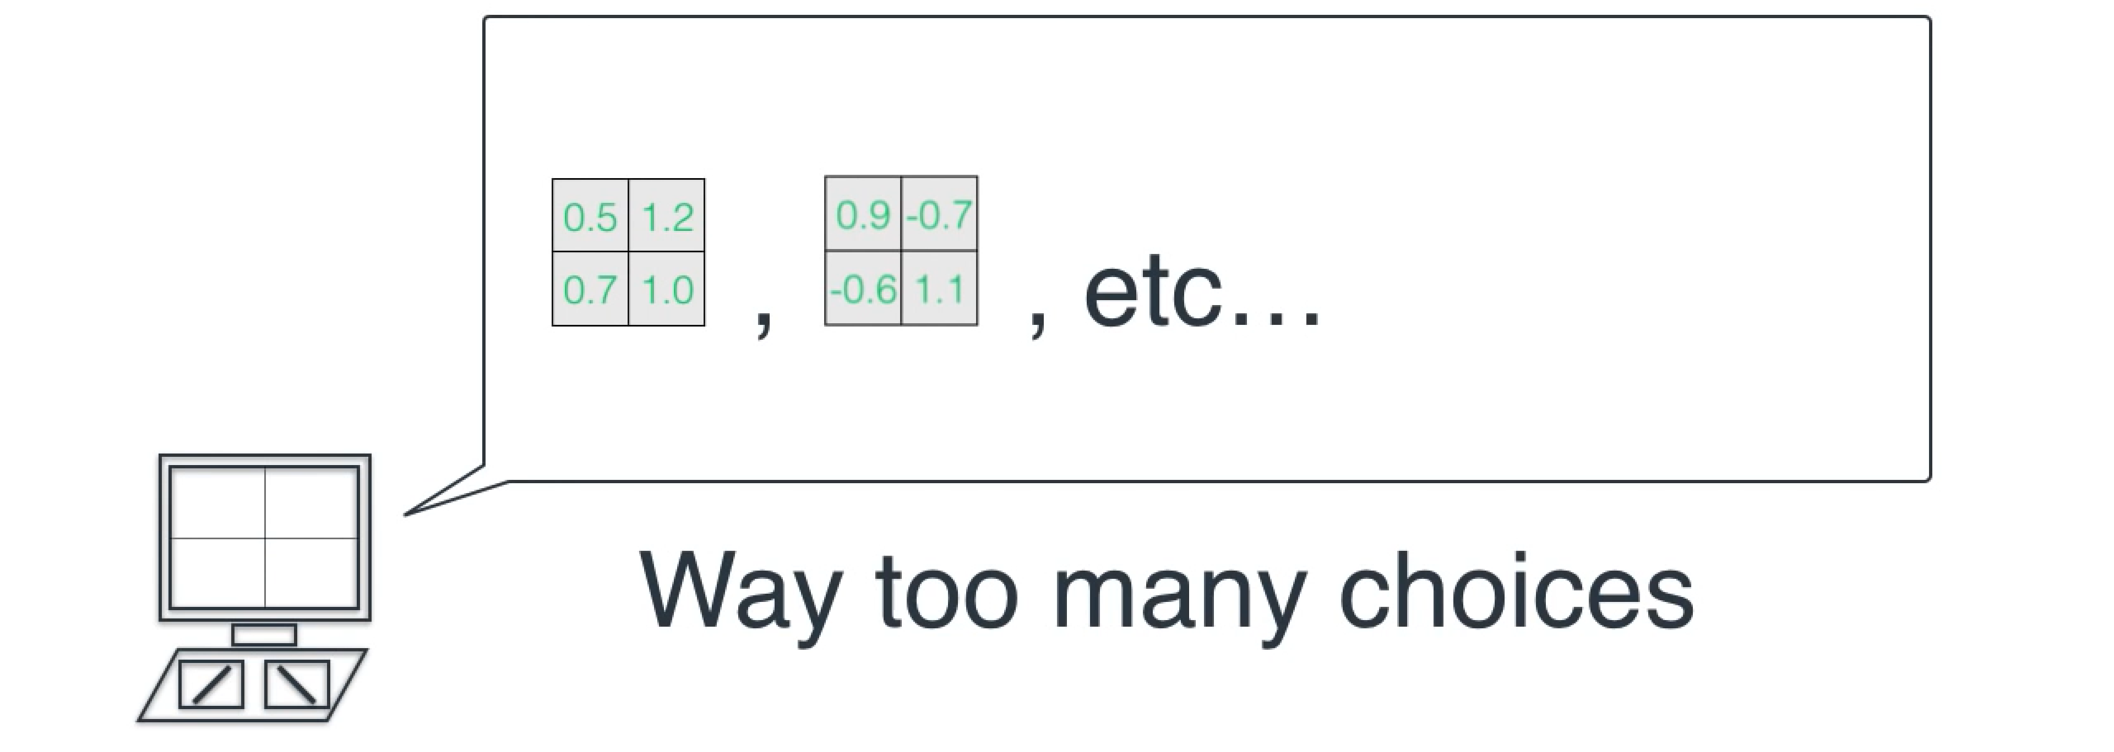
Convolution Neural Network (CNN)
A simple world

Slide 41
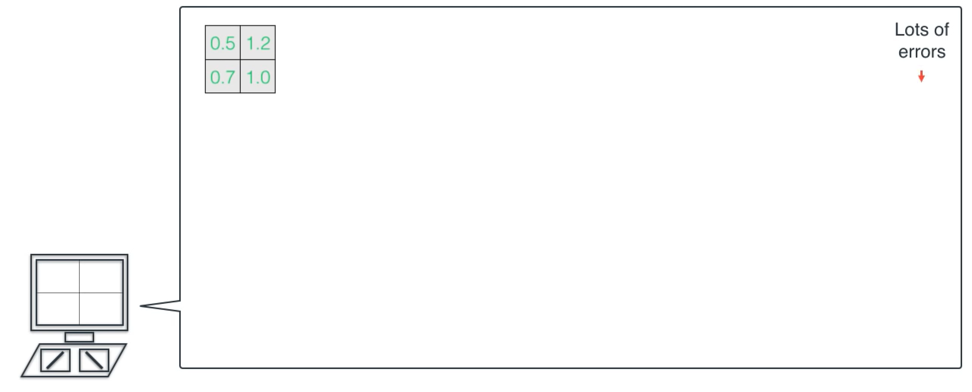
Convolution Neural Network (CNN)
A simple world

Slide 42
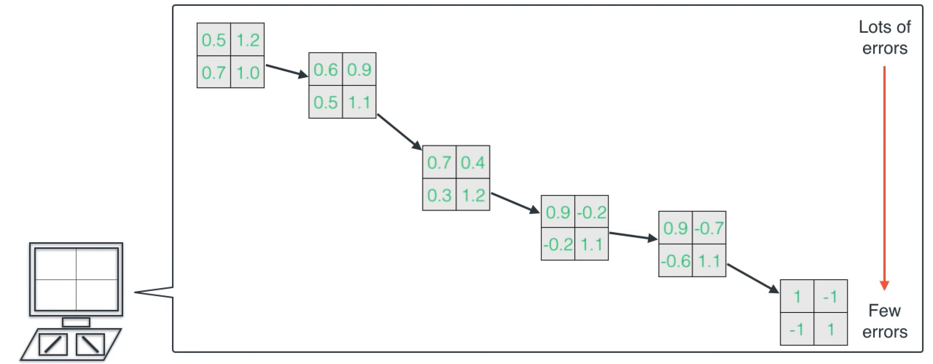
Convolution Neural Network (CNN)
A simple world

Slide 43
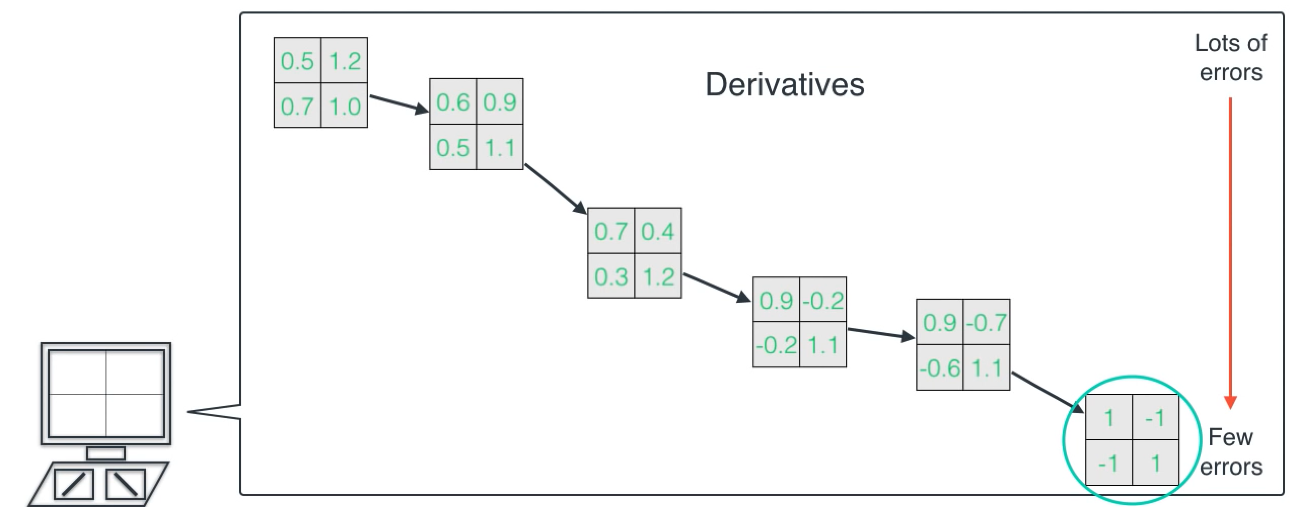
Convolution Neural Network (CNN)
A simple world

Slide 44
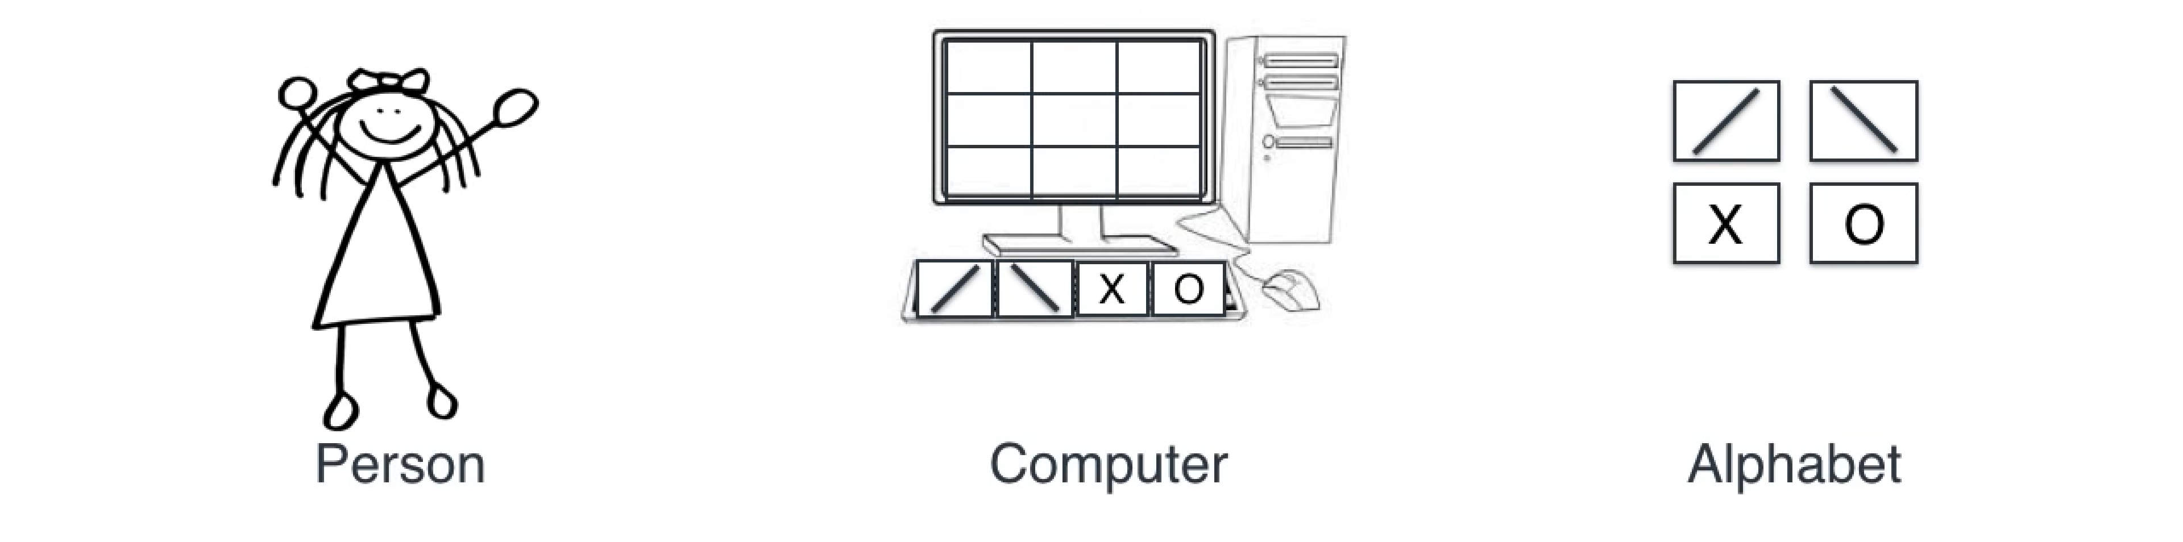
Convolution Neural Network (CNN)
A little more complex world

Slide 45
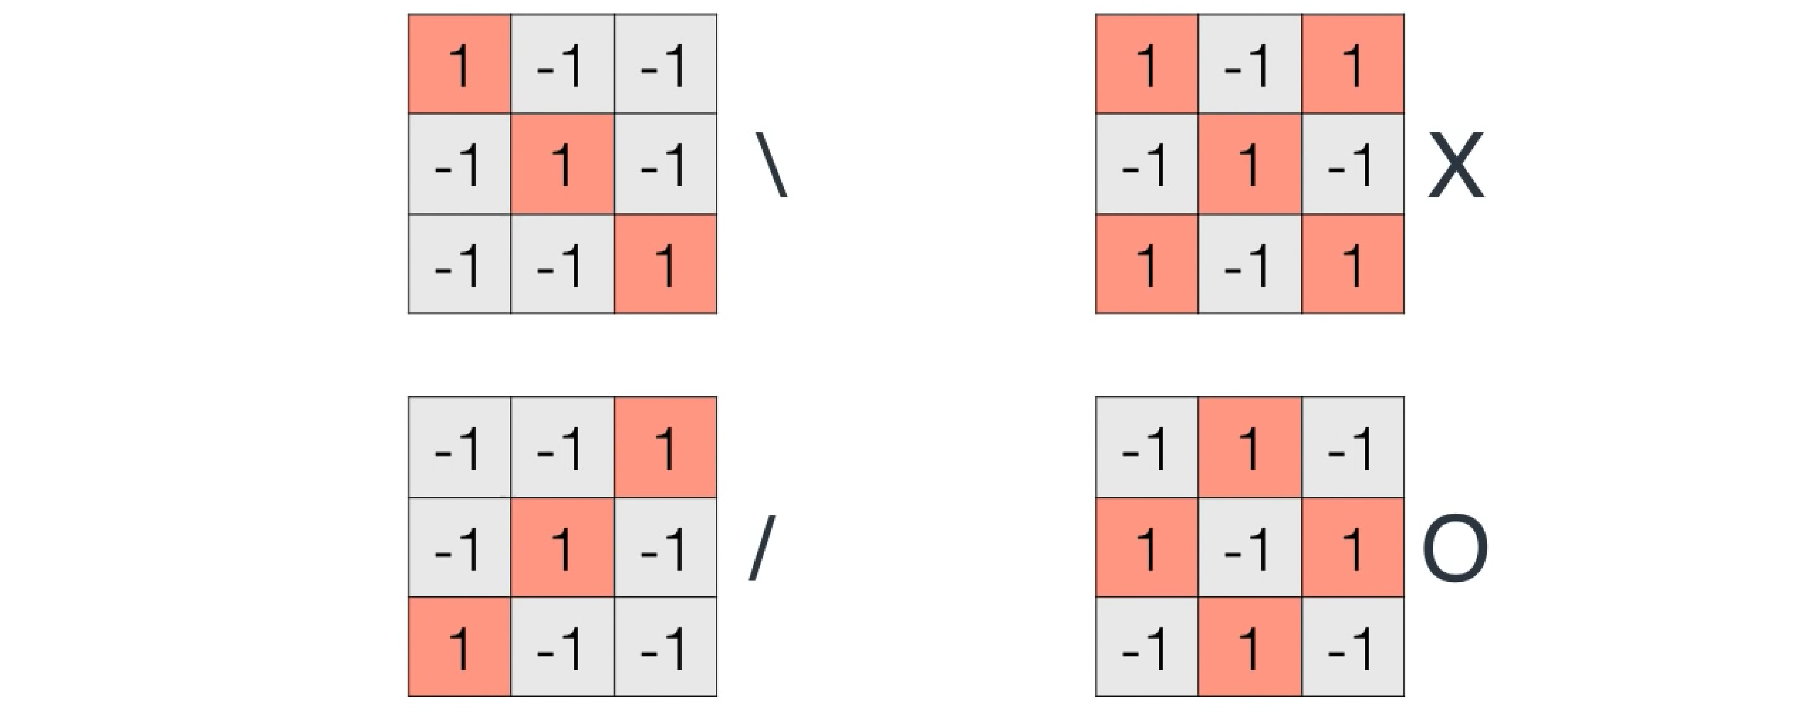
Convolution Neural Network (CNN)
A little more complex world

Slide 46
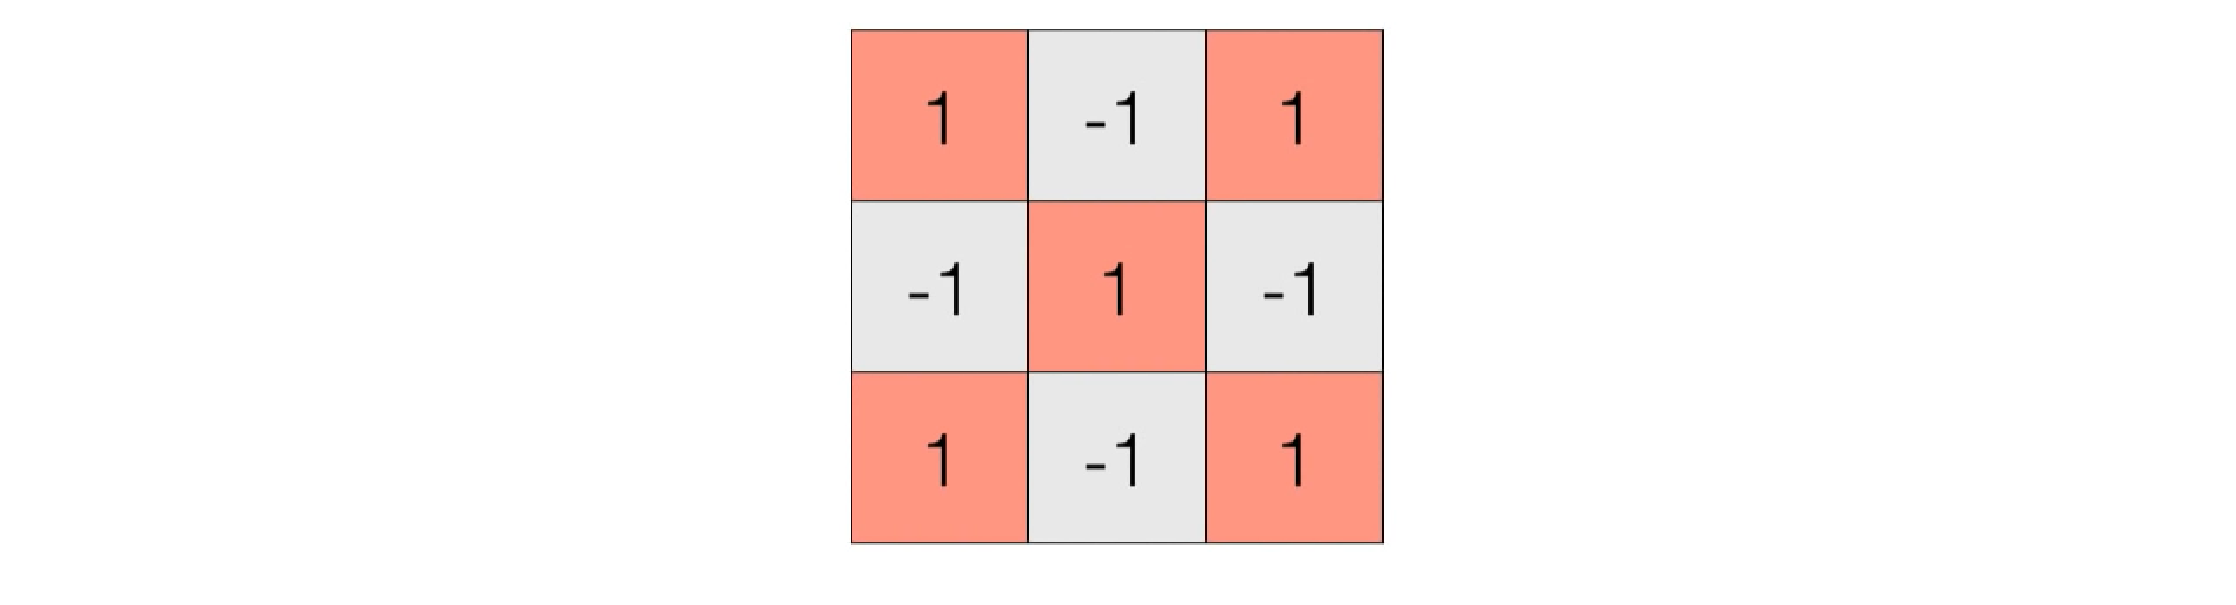
Convolution Neural Network (CNN)
A little more complex world

Slide 47
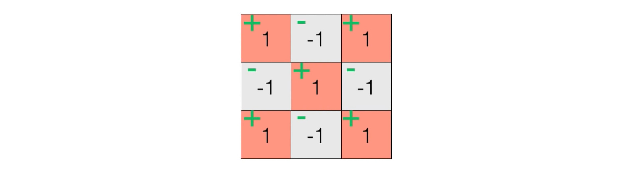
Convolution Neural Network (CNN)
A little more complex world

Slide 48
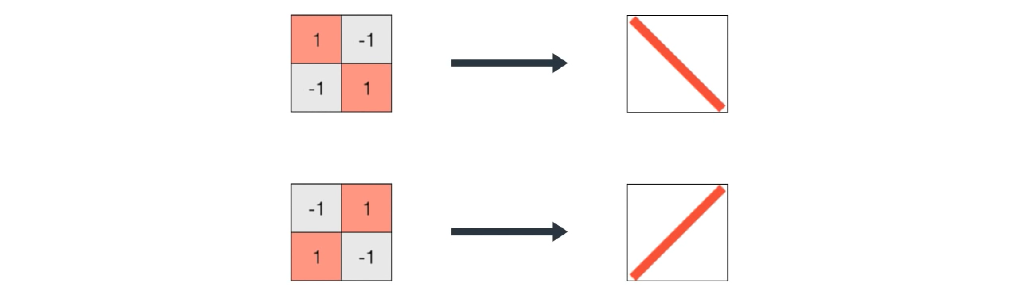
Convolution Neural Network (CNN)
A little more complex world

Slide 49
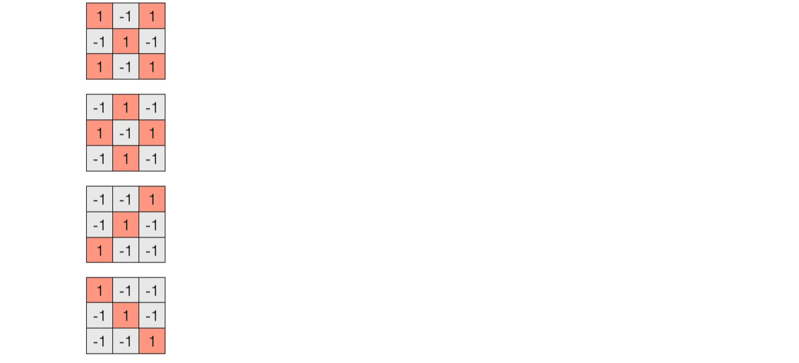
Convolution Neural Network (CNN)
A little more complex world

Slide 50
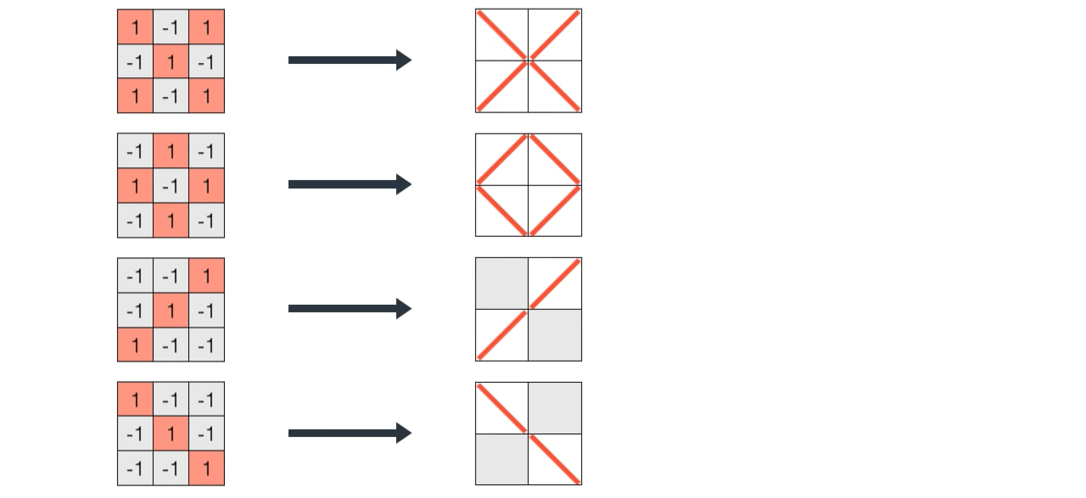
Convolution Neural Network (CNN)
A little more complex world

Slide 51
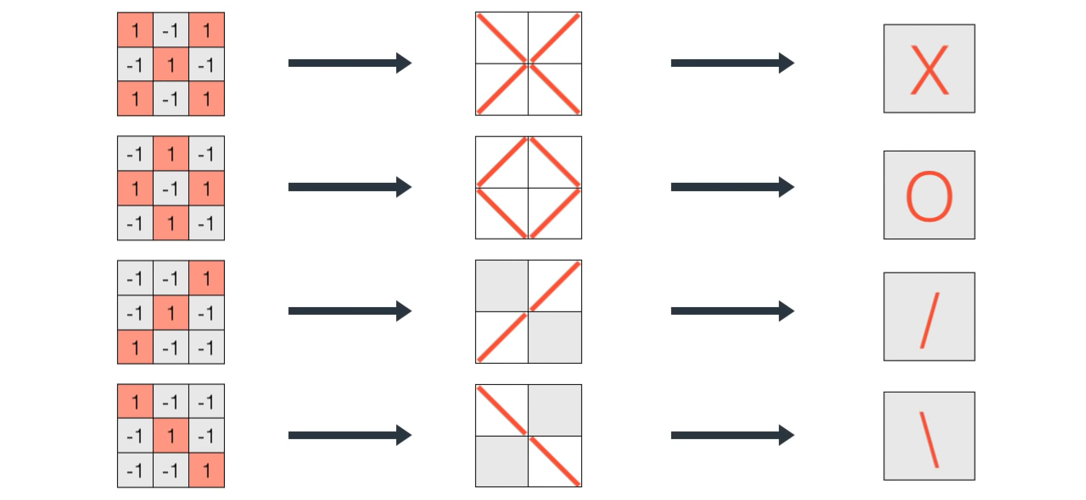
Convolution Neural Network (CNN)
A little more complex world

Slide 52
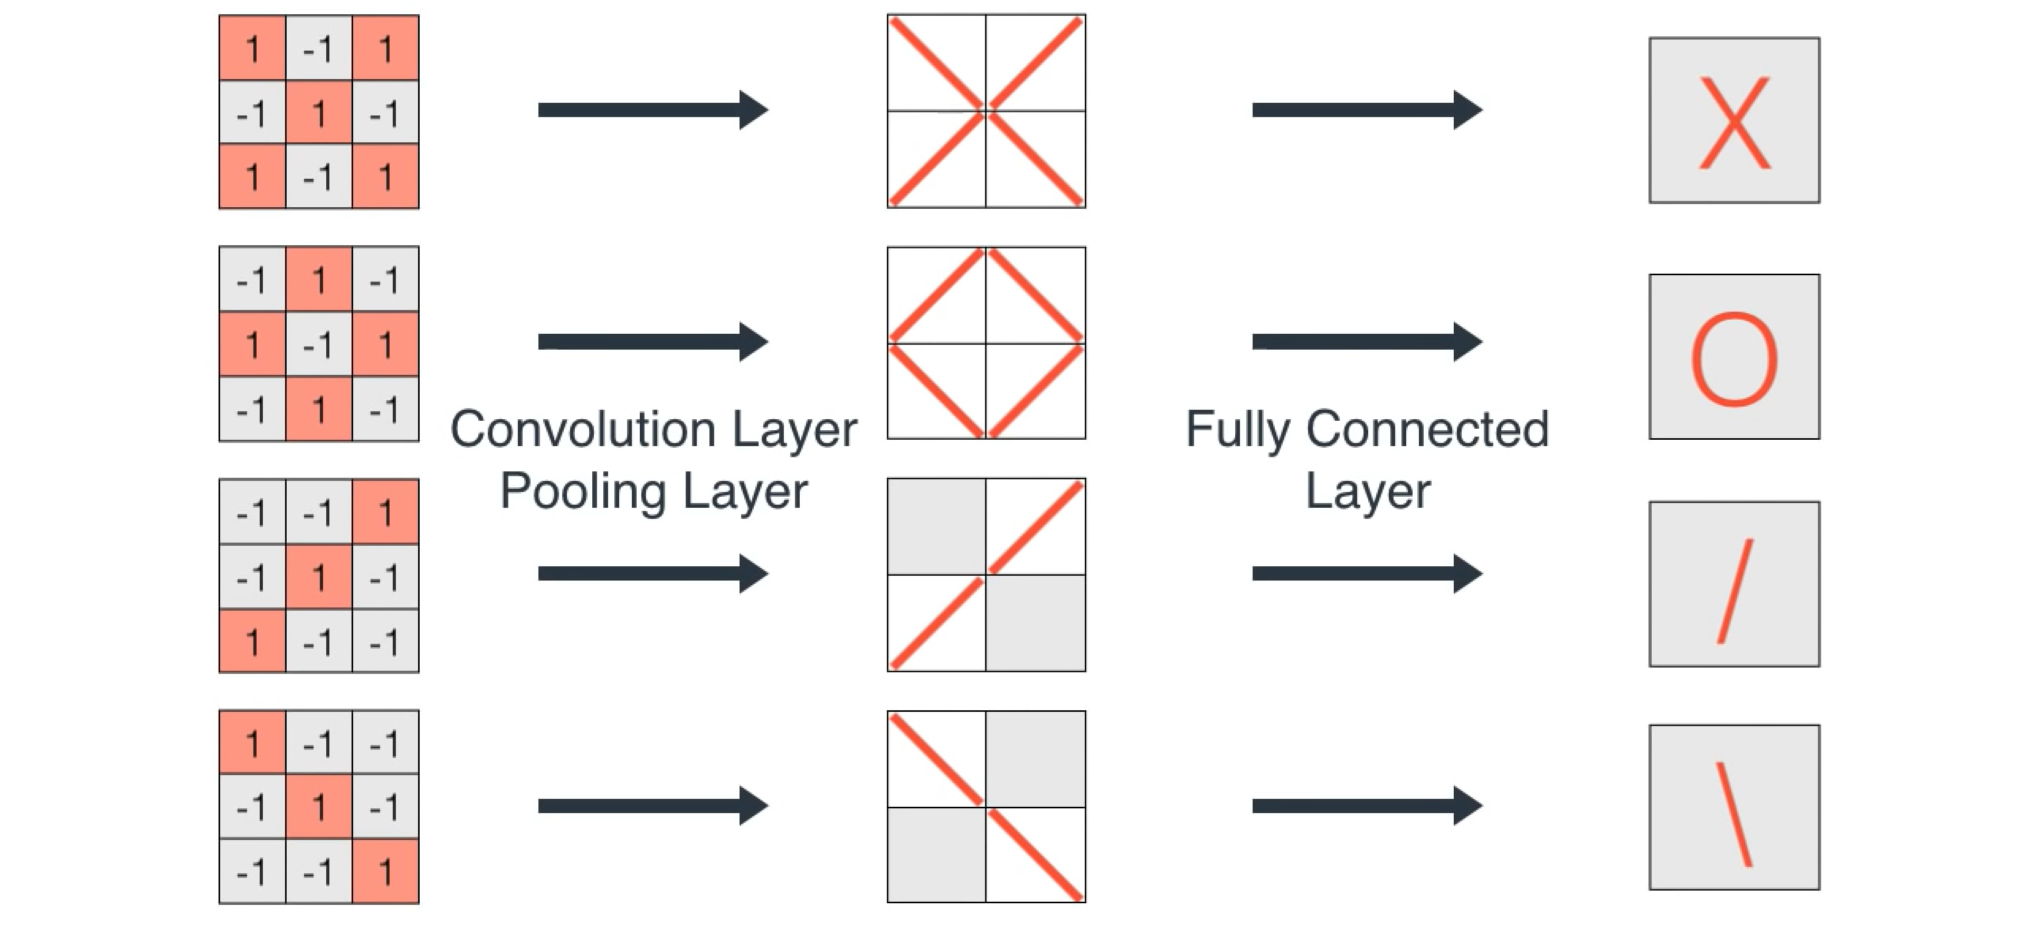
Convolution Neural Network (CNN)
A little more complex world

Slide 53
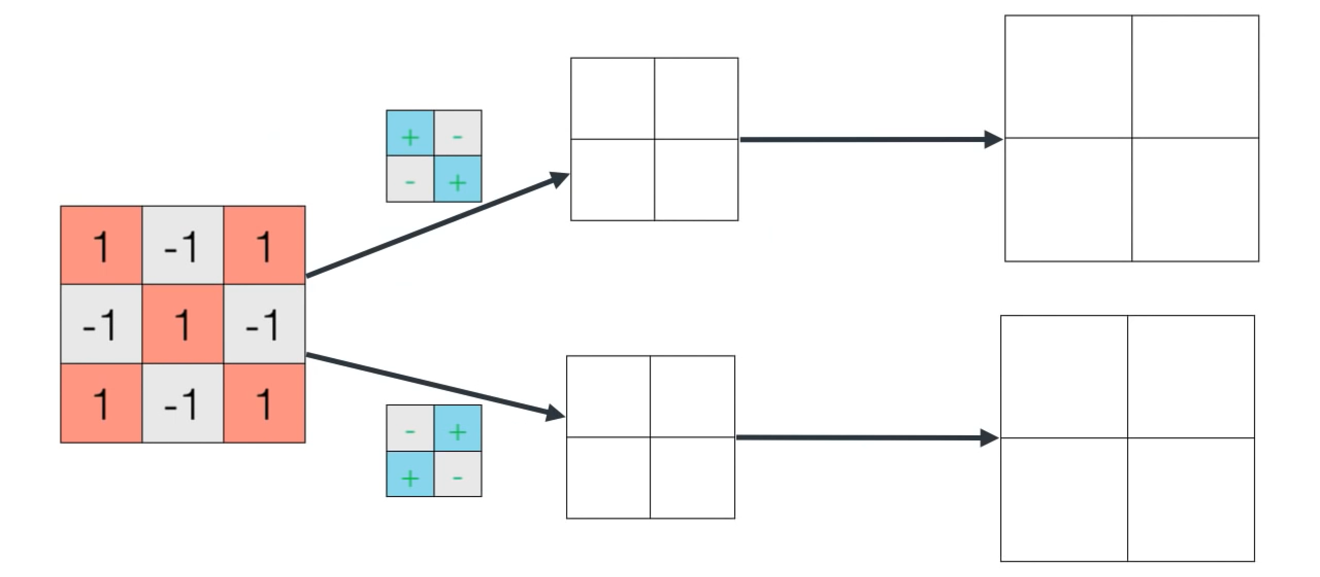
Convolution Neural Network (CNN)
A little more complex world

Slide 54
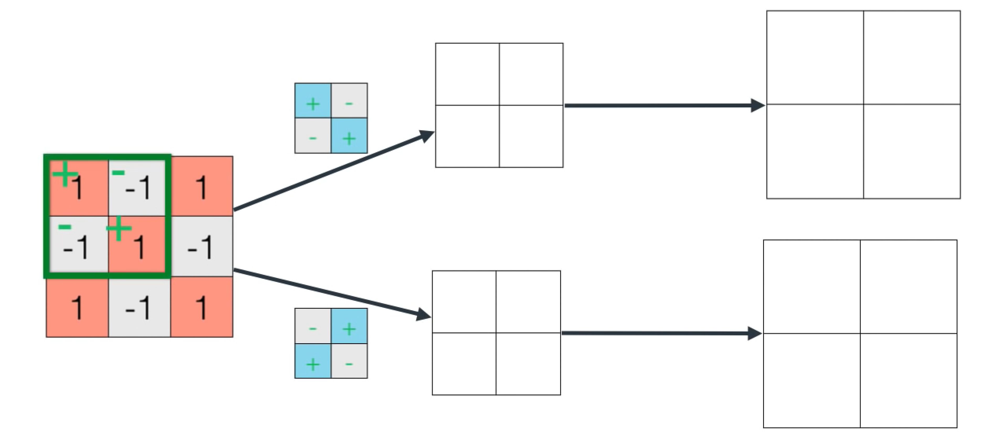
Convolution Neural Network (CNN)
A little more complex world

Slide 55
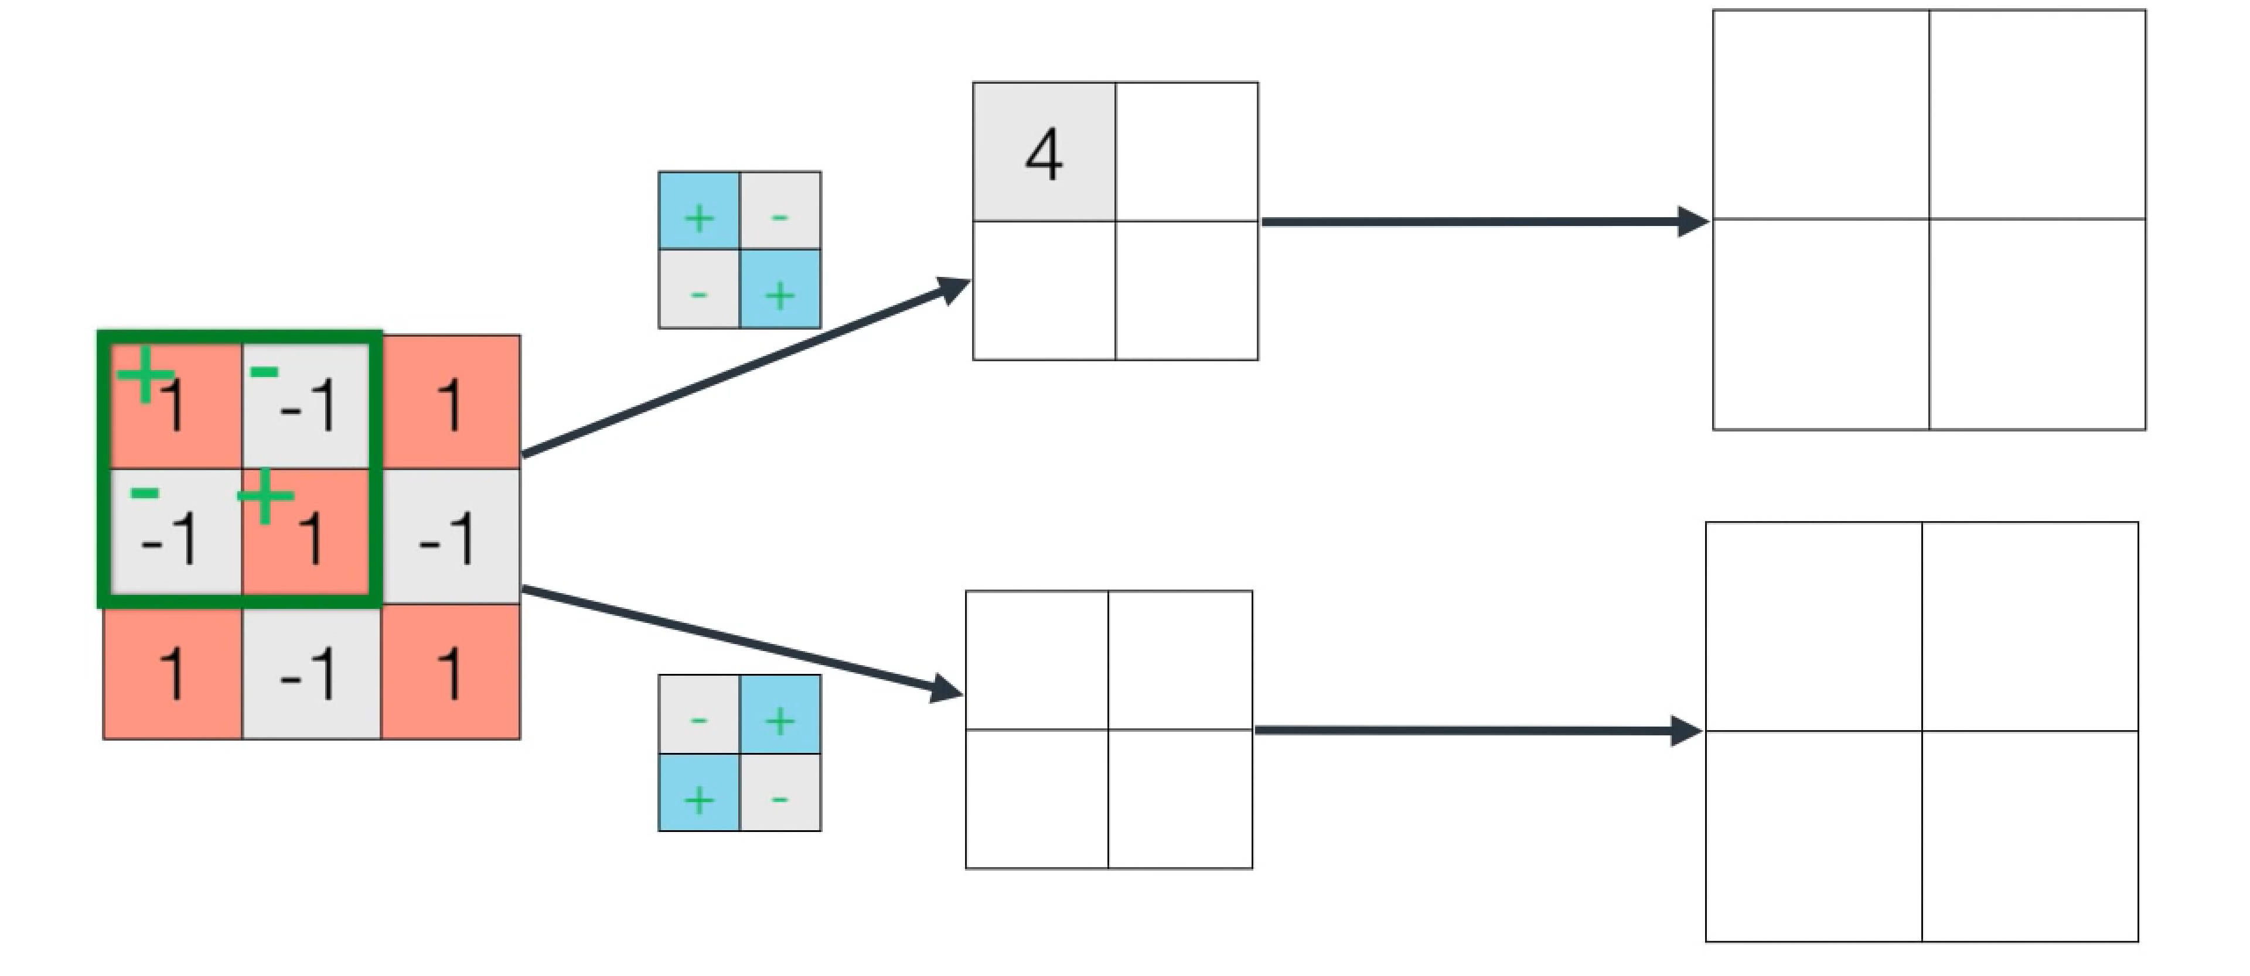
Convolution Neural Network (CNN)
A little more complex world

Slide 56
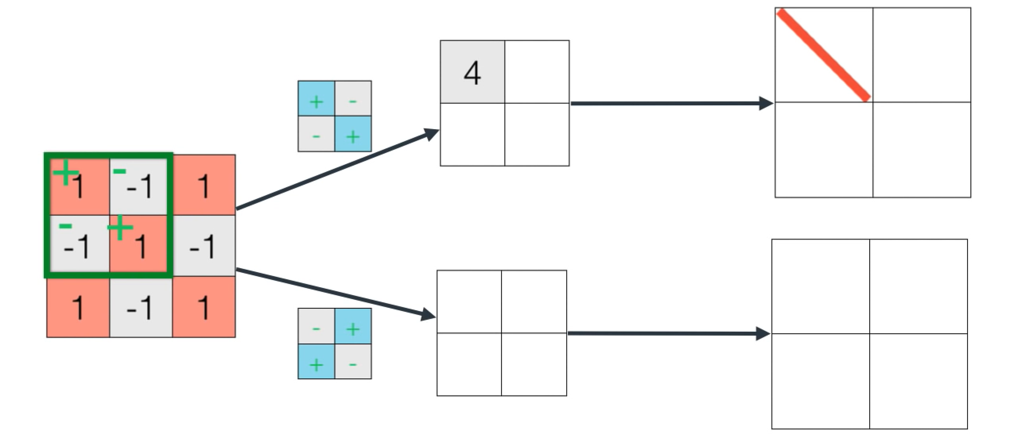
Convolution Neural Network (CNN)
A little more complex world

Slide 57

Convolution Neural Network (CNN)
A little more complex world

Slide 58

Convolution Neural Network (CNN)
A little more complex world

Slide 59

Convolution Neural Network (CNN)
A little more complex world

Slide 60

Convolution Neural Network (CNN)
A little more complex world

Slide 61

Convolution Neural Network (CNN)
A little more complex world

Slide 62

Convolution Neural Network (CNN)
A little more complex world

Slide 63

Convolution Neural Network (CNN)
A little more complex world

Slide 64

Convolution Neural Network (CNN)
A little more complex world

Slide 65

Convolution Neural Network (CNN)
A little more complex world

Slide 66

Convolution Neural Network (CNN)
A little more complex world

Slide 67

Convolution Neural Network (CNN)
A little more complex world

Slide 68

Convolution Neural Network (CNN)
A little more complex world

Slide 69

Convolution Neural Network (CNN)
A little more complex world

Slide 70

Convolution Neural Network (CNN)
A little more complex world

Slide 71

Convolution Neural Network (CNN)
A little more complex world

Slide 72

Convolution Neural Network (CNN)
A little more complex world

Slide 73

Convolution Neural Network (CNN)
A little more complex world

Slide 74

Convolution Neural Network (CNN)
A little more complex world

Slide 75

Convolution Neural Network (CNN)
A little more complex world

Slide 76

Convolution Neural Network (CNN)
A little more complex world

Slide 77

Convolution Neural Network (CNN)
A little more complex world

Slide 78

Convolution Neural Network (CNN)
A little more complex world

Slide 79

Convolution Neural Network (CNN)
A little more complex world

Slide 80

Convolution Neural Network (CNN)
A little more complex world

Slide 81

Convolution Neural Network (CNN)
A little more complex world

Slide 82

Convolution Neural Network (CNN)
A little more complex world

Slide 83

Convolution Neural Network (CNN)
A little more complex world

Slide 84

Convolution Neural Network (CNN)
A little more complex world

Slide 85

Convolution Neural Network (CNN)
A little more complex world

Slide 86

Convolution Neural Network (CNN)
A little more complex world

Slide 87

Convolution Neural Network (CNN)
A little more complex world

Slide 88

Convolution Neural Network (CNN)
A little more complex world

Slide 89

Convolution Neural Network (CNN)
A little more complex world

Slide 90

Convolution Neural Network (CNN)
A little more complex world

Slide 91

Convolution Neural Network (CNN)
A little more complex world

Slide 92

Convolution Neural Network (CNN)
A little more complex world

Slide 93

Convolution Neural Network (CNN)
A little more complex world

Slide 94

Convolution Neural Network (CNN)
A little more complex world

Slide 95

Convolution Neural Network (CNN)
A little more complex world

Slide 96

Convolution Neural Network (CNN)
A little more complex world

Slide 97

Convolution Neural Network (CNN)
A little more complex world

Slide 98

Convolution Neural Network (CNN)
A little more complex world

Slide 99

Convolution Neural Network (CNN)
A little more complex world

Slide 100

Convolution Neural Network (CNN)
A little more complex world

Slide 101

Convolution Neural Network (CNN)
A little more complex world

Slide 102

Convolution Neural Network (CNN)
A little more complex world

Slide 103

Convolution Neural Network (CNN)
A little more complex world

Slide 104

Convolution Neural Network (CNN)
A little more complex world

Slide 105

Convolution Neural Network (CNN)
A little more complex world

Slide 106

Convolution Neural Network (CNN)
A little more complex world

Slide 107

Convolution Neural Network (CNN)
A little more complex world

Slide 108

Convolution Neural Network (CNN)
A little more complex world

Slide 109


Convolution Neural Network (CNN)
Advanced world

Slide 110

Convolution Neural Network (CNN)

Slide 111


Slide 112

Convolution Neural Network (CNN)

Slide 113

Convolution Neural Network (CNN)

Slide 114

Convolution Neural Network (CNN)
Advanced world

Slide 115

Convolution Neural Network (CNN)
GoogLeNet (Inception)

Slide 116

Notes:
When you give an image to a computer, it’s just a bunch of pixels. It doesn’t really know anything about its contents. To simulate that, here’s an image, and I’ve blurred it, so you probably don’t know what it is.
With images, you can apply filters to extract information. You’ve probably seen tools like photoshop where you can sharpen images, or detect edges or stuff like that. Those are filters, which are just sets of numbers.
So what, for example if I could apply a filter to this image that does this...

Slide 117

Notes:
And detects these things. They look like human legs.

Slide 118

Notes:
And then maybe another filter detects these things. They look like human hands.

Slide 119

Notes:
And then maybe another filter detects this….it looks like a human face

Slide 120
Notes:
So, by applying these filters, I can get legs...

Slide 121
+
Notes:
...plus hands...

Slide 122
+
+
Notes:
….plus a face….

Slide 123
+
+
=
HUMAN
Notes:
And if I had already labelled the image that works with these filters as a human, I can have a computer learn that when it detects these three features, using filters, then what it sees in the image is a human

Slide 124



+
+
=
HUMAN
=
HORSE
+
+
Notes:
And similarly, if other filters detect things that look like these, then, when the computer applies those filters to an image, and all three of them produce something, it’s labeleld as a horse.

Slide 125
Filters extract features like hands
+
+
=
HUMAN
=
HORSE
+
+
Notes:
So, over time, in the same way as with activity recognition earlier, if the computer can figure out which filters extract the features that determine the difference between the answer of a human and the answer of a horse...

Slide 126
Filters extract features like hands
+
+
=
HUMAN
Or ears
=
HORSE
+
+
Notes:
..., we begin to get a set of rules that determine the difference between a horse and a human!

Slide 127
+
+
=
HORSE
Filters can then be combined with labels to make a prediction of the image contents...
Notes:
And then, in the future, if we pass it a new image, depending on which filters work with it...

Slide 128
+
+
=
HORSE
Filters can then be combined with labels to make a prediction of the image contents...
The filters that match the label are learned over time!
Notes:
...we can predict what’s in the image. These filters are randomly initialized, but over time, using the loop we showed earlier, their values can be measured for accuracy, then optimized and so on. The values that match data to labels can be learned over time.

Slide 129



+
+
=
?
Model
Data
Inferences
Notes:
So when we pass data into the model we can get inferences out

Slide 130
+
+
=
HUMAN
Model
Data
Inferences
Notes:
And we have a model, which contains the learned filters, and in the future if we pass it an image, it can detect the features that, for example, determine if the picture contains a horse or a human -- and in this case it’s clearly a human

Slide 131
The Machine Learning Paradigm
Make a Guess!
Measure your accuracy
Optimize your Guess
Repeat
Notes:
So remember this loop -- we make a guess, we measure the accuracy of that guess, and we then optimize the next guess, repeating this across all our data a number of times

Slide 132
The Machine Learning Paradigm
Randomly initialize filters. Apply them to images, and make a guess which ones match labels to images
Make a Guess!
Measure your accuracy
Optimize your Guess
Repeat
Notes:
In the case of computer vision our guess is to randomly initialize the values of the filters. Apply them to all images, and then try to determine which ones work to extract features that get matched to the labels.

Slide 133
The Machine Learning Paradigm
Check to see how many of your filters work to match images to labels
Make a Guess!
Measure your accuracy
Optimize your Guess
Repeat
Notes:
Then we can compare the results of our guesses and their matching, with the actual labels to see how good or bad our guesses were

Slide 134
The Machine Learning Paradigm
Use the data from the previous steps to tweak your set of filters...
Make a Guess!
Measure your accuracy
Optimize your Guess
Repeat
Notes:
Then we use the data from this to tweak our set of filters, or other parameters, to improve the accuracy

Slide 135
The Machine Learning Paradigm
Make a Guess!
Measure your accuracy
Optimize your Guess
Repeat
...and Repeat
Notes:
And we repeat.

Slide 136
+
+
=
?
Notes:
So, for example, if my filters look like this...and I’m extracting features...

Slide 137
+
+
=
HUMAN
Notes:
...and I can reliably match these to a label, such as ‘Human’....

Slide 138

+
+
=
HUMAN
Notes:
...then in the future, when using these filters, I can confidently predict that the image contains a human. And in fact it does, like we can see here.

Slide 139
model = tf.keras.models.Sequential([
tf.keras.layers.Conv2D(16, (3, 3), activation='relu', input_shape=(300, 300, 3)),
tf.keras.layers.MaxPooling2D(2, 2),
tf.keras.layers.Conv2D(32, (3, 3), activation='relu'),
tf.keras.layers.MaxPooling2D(2, 2),
tf.keras.layers.Conv2D(64, (3, 3), activation='relu'),
tf.keras.layers.MaxPooling2D(2, 2),
tf.keras.layers.Flatten(),
tf.keras.layers.Dense(512, activation='relu'),
tf.keras.layers.Dense(1, activation='sigmoid')
])
Notes:
So what does this look like in code? In TensorFlow we can define a model as a number of layers, where each layer is a piece of functionality, and it defines what we want the machine to learn

Slide 140
model = tf.keras.models.Sequential([
tf.keras.layers.Conv2D(16, (3, 3), activation='relu', input_shape=(300, 300, 3)),
tf.keras.layers.MaxPooling2D(2, 2),
tf.keras.layers.Conv2D(32, (3, 3), activation='relu'),
tf.keras.layers.MaxPooling2D(2, 2),
tf.keras.layers.Conv2D(64, (3, 3), activation='relu'),
tf.keras.layers.MaxPooling2D(2, 2),
tf.keras.layers.Flatten(),
tf.keras.layers.Dense(512, activation='relu'),
tf.keras.layers.Dense(1, activation='sigmoid')
])
Conv2D stands for 2D Convolution -- another word for a filter
Notes:
Conv2D stands for convolution 2D, another word for filter. And because this is quite a sophisticated scenario, applying filters to the image probably isn’t enough, we have to apply filters to an image, then filter those results, and then filter those results again, which is why there are 3 layers of filters

Slide 141
model = tf.keras.models.Sequential([
tf.keras.layers.Conv2D(16, (3, 3), activation='relu', input_shape=(300, 300, 3)),
tf.keras.layers.MaxPooling2D(2, 2),
tf.keras.layers.Conv2D(32, (3, 3), activation='relu'),
tf.keras.layers.MaxPooling2D(2, 2),
tf.keras.layers.Conv2D(64, (3, 3), activation='relu'),
tf.keras.layers.MaxPooling2D(2, 2),
tf.keras.layers.Flatten(),
tf.keras.layers.Dense(512, activation='relu'),
tf.keras.layers.Dense(1, activation='sigmoid')
])
MaxPooling is a way of compressing the image while enhancing features
Notes:
In between these layers, are things called MaxPooling, which, while they aren’t necessary, they are really useful. Max Pooling is a technique that compresses the image, while maintaining the results of the filter. This means the next filters have less pixels to work with, and will speed things up when you’re processing lots of images

Slide 142
model = tf.keras.models.Sequential([
tf.keras.layers.Conv2D(16, (3, 3), activation='relu', input_shape=(300, 300, 3)),
tf.keras.layers.MaxPooling2D(2, 2),
tf.keras.layers.Conv2D(32, (3, 3), activation='relu'),
tf.keras.layers.MaxPooling2D(2, 2),
tf.keras.layers.Conv2D(64, (3, 3), activation='relu'),
tf.keras.layers.MaxPooling2D(2, 2),
tf.keras.layers.Flatten(),
tf.keras.layers.Dense(512, activation='relu'),
tf.keras.layers.Dense(1, activation='sigmoid')
])
Dense is a neural network that matches the filters to the labels
Notes:
After you have all the filters learned, then the idea is to match the filters to the labels, and a Dense Neural network does that really effectively, so the results of all the filtered images (things that I demonstrated using legs, hands, head), will be matched to the labels, so that those extracted features can be matched to the relevant label -- so human-looking legs get matched to human, horse-looking legs get matched to horse etc.

Slide 143
model = tf.keras.models.Sequential([
tf.keras.layers.Conv2D(16, (3, 3), activation='relu', input_shape=(300, 300, 3)),
tf.keras.layers.MaxPooling2D(2, 2),
tf.keras.layers.Conv2D(32, (3, 3), activation='relu'),
tf.keras.layers.MaxPooling2D(2, 2),
tf.keras.layers.Conv2D(64, (3, 3), activation='relu'),
tf.keras.layers.MaxPooling2D(2, 2),
tf.keras.layers.Flatten(),
tf.keras.layers.Dense(512, activation='relu'),
tf.keras.layers.Dense(1, activation='sigmoid')
])
The final Dense represents the labels -
Horse = 0, Human = 1
Notes:
The last thing is the output of the model is defined -- and this is a neuron also. As we only have 2 types of ‘class’ here -- horse or human, we can use a single neuron, where if it ends up as 0 it’s a horse, otherwise it’s a human

Slide 144

Notes:
When you give an image to a computer, it’s just a bunch of pixels. It doesn’t really know anything about its contents. To simulate that, here’s an image, and I’ve blurred it, so you probably don’t know what it is.
With images, you can apply filters to extract information. You’ve probably seen tools like photoshop where you can sharpen images, or detect edges or stuff like that. Those are filters, which are just sets of numbers.
So what, for example if I could apply a filter to this image that does this...

Slide 145
optimizer = tf.keras.optimizers.RMSprop(lr=0.001)
model.compile(loss='binary_crossentropy',
optimizer=optimizer,
metrics=['accuracy'])
Notes:
Once the model is defined, we then have to define how it works in training.

Slide 146
optimizer = tf.keras.optimizers.RMSprop(lr=0.001)
model.compile(loss='binary_crossentropy',
optimizer=optimizer,
metrics=['accuracy'])
Make a Guess!
Measure your accuracy
Optimize your Guess
Repeat
Notes:
So if we remember this diagram -- make a guess, measure accuracy, optimize -- it’s done in this code.
First of all, when we defined the model -- all of the parameters, the filters, the values of the neurons, were randomly initialized. It made a guess in other words. As we have only horses or humans, a randomly initialized model would be expected to be 50% accurate

Slide 147
optimizer = tf.keras.optimizers.RMSprop(lr=0.001)
model.compile(loss='binary_crossentropy',
optimizer=optimizer,
metrics=['accuracy'])
Make a Guess!
Measure your accuracy
Optimize your Guess
Repeat
Notes:
So we can measure that accuracy using something called a loss function. There’s lots of built in loss functions in tensorflow, so it becomes as matter of choosing the right one for your model. I chose one called binary crossentropy as there are only 2 classes here

Slide 148
optimizer = tf.keras.optimizers.RMSprop(lr=0.001)
model.compile(loss='binary_crossentropy',
optimizer=optimizer,
metrics=['accuracy'])
Make a Guess!
Measure your accuracy
Optimize your Guess
Repeat
Notes:
The next step is to then optimize your guess, and in this case we’re optimizing using a technique called RMSProp (root mean square propogation), which you can choose from a number of options. This will take the data that it has -- the random initialization of the parameters in the network, the accuracy etc, and then update all the values with a ‘new’ guess…
...and we then repeat. We started with close to 50%, but now, because of what we have gathered, the next iteration might go up to 60%
This is what gives machine learning it’s name. By going through this process, it’s learning the parameters that best match the data to the labels

Slide 149
model.fit(train_generator, epochs=12, ...)
Notes:
The next piece of code is called model.fit -- and it has that name because it is fitting the answers to the labels in order to figure out the rules...

Slide 150
model.fit(train_generator, epochs=12, ...)
Make a Guess!
Measure your accuracy
Optimize your Guess
Repeat
Notes:
And the epochs parameter defines how many times you’ll repeat this process.
As the model gets better and better at matching the data to the labels, the process convergence is used.
It takes time to figure out how many epochs, what model architecture, what parameters etc will lead to convergence, and skilled ML developers will be able to reach convergence quickly

Slide 151



@vinicius caridá
@vfcarida
vfcarida@gmail.com
https://linktr.ee/vfcarida

